Slide 1

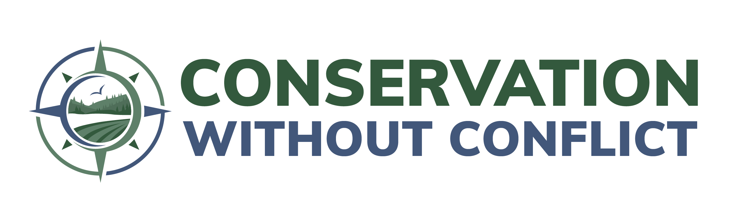
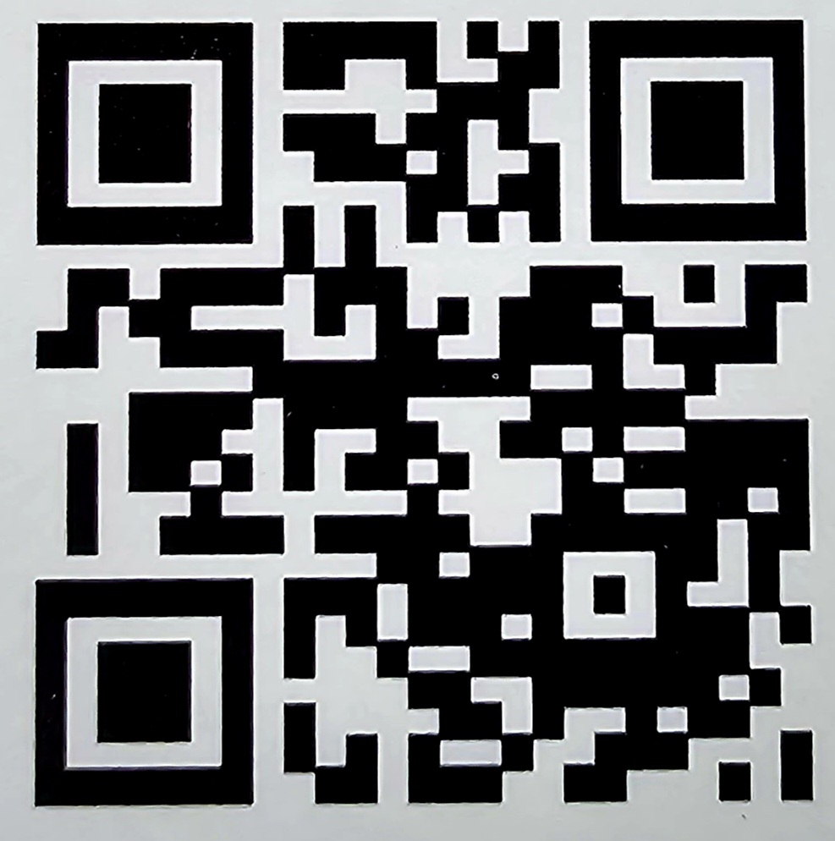
A proven approach for wildlife conservation on working lands
2024 Summit
February 20-22
Arlington, VA

Slide 2

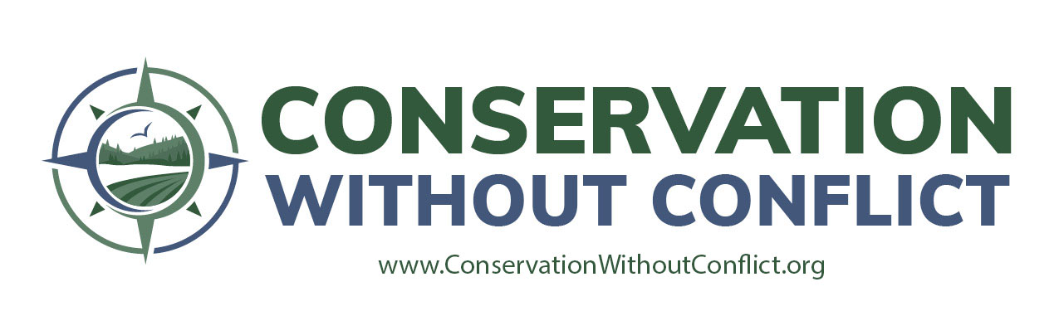
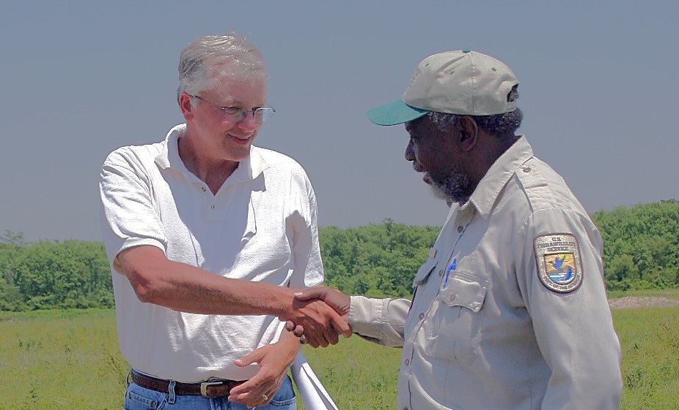
A concept and a coalition that frames a collective vision of voluntary collaboration with working forests, farms and ranches
The culture for voluntary collaboration across diverse sectors and groups
Working landscapes integral to success
Mutually beneficial conservation and economic sustainability at scale

Slide 3


What is Conservation Without Conflict?
Conservation Without Conflict is both a proven approach to conservation and a coalition of public and private partners with highly diverse goals who are united in their commitment to conserving wildlife while keeping America’s working lands working. Our coalition emphasizes:
INNOVATIVE VOLUNTARY COLLABORATIVE
approaches to conserving wildlife on working lands, rather than the historically contentious – and even litigious – approaches of the past.
Together, we are establishing an enduring cultural shift across diverse stakeholder groups, yielding a transformational change in the way we achieve conservation.

Slide 4
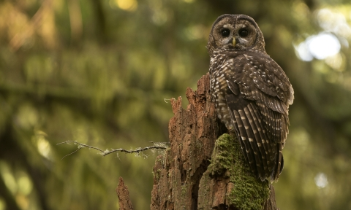
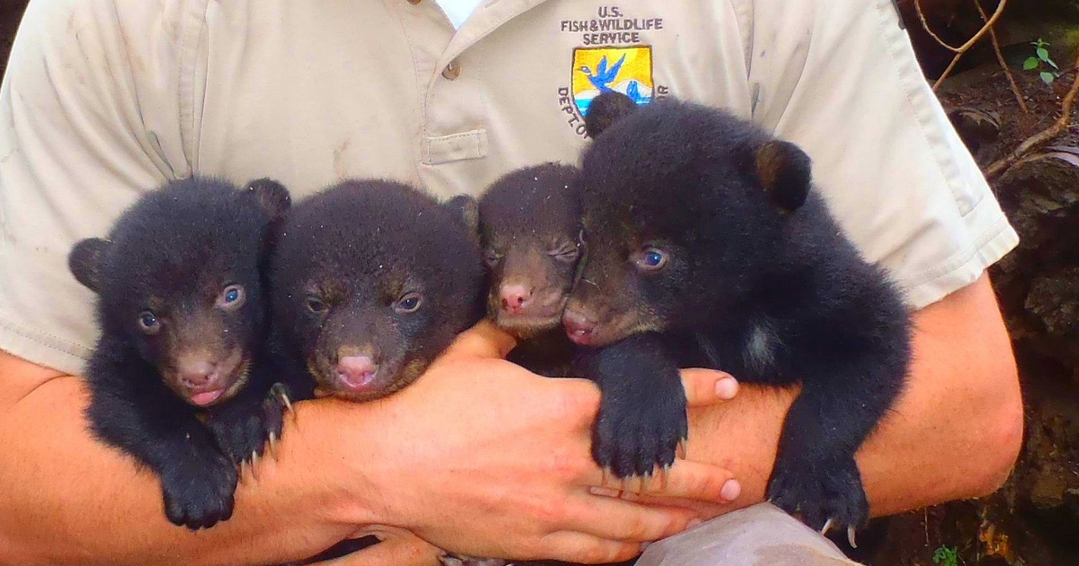
Conservation Without Conflict can be traced back to 1990!
June 21, 1990 Louisiana black bear threatened listing proposed
June 23, 1990
Northern spotted owl
listed as threatened

Slide 5
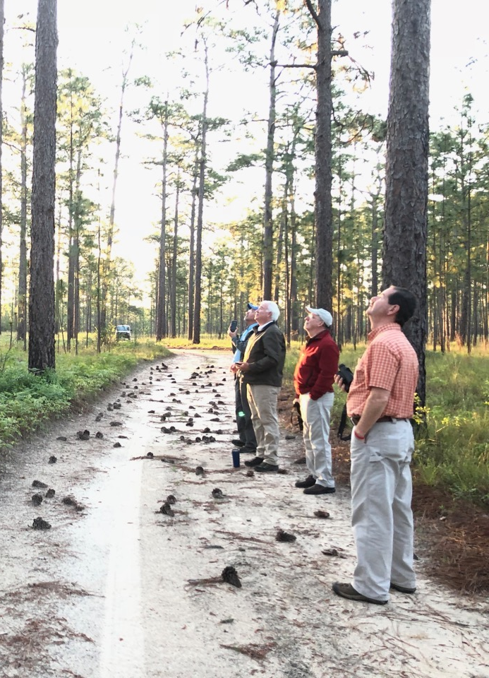

OUR VISION
For voluntary collaboration to be the preferred model for wildlife conservation on working lands across the United States.

Slide 6
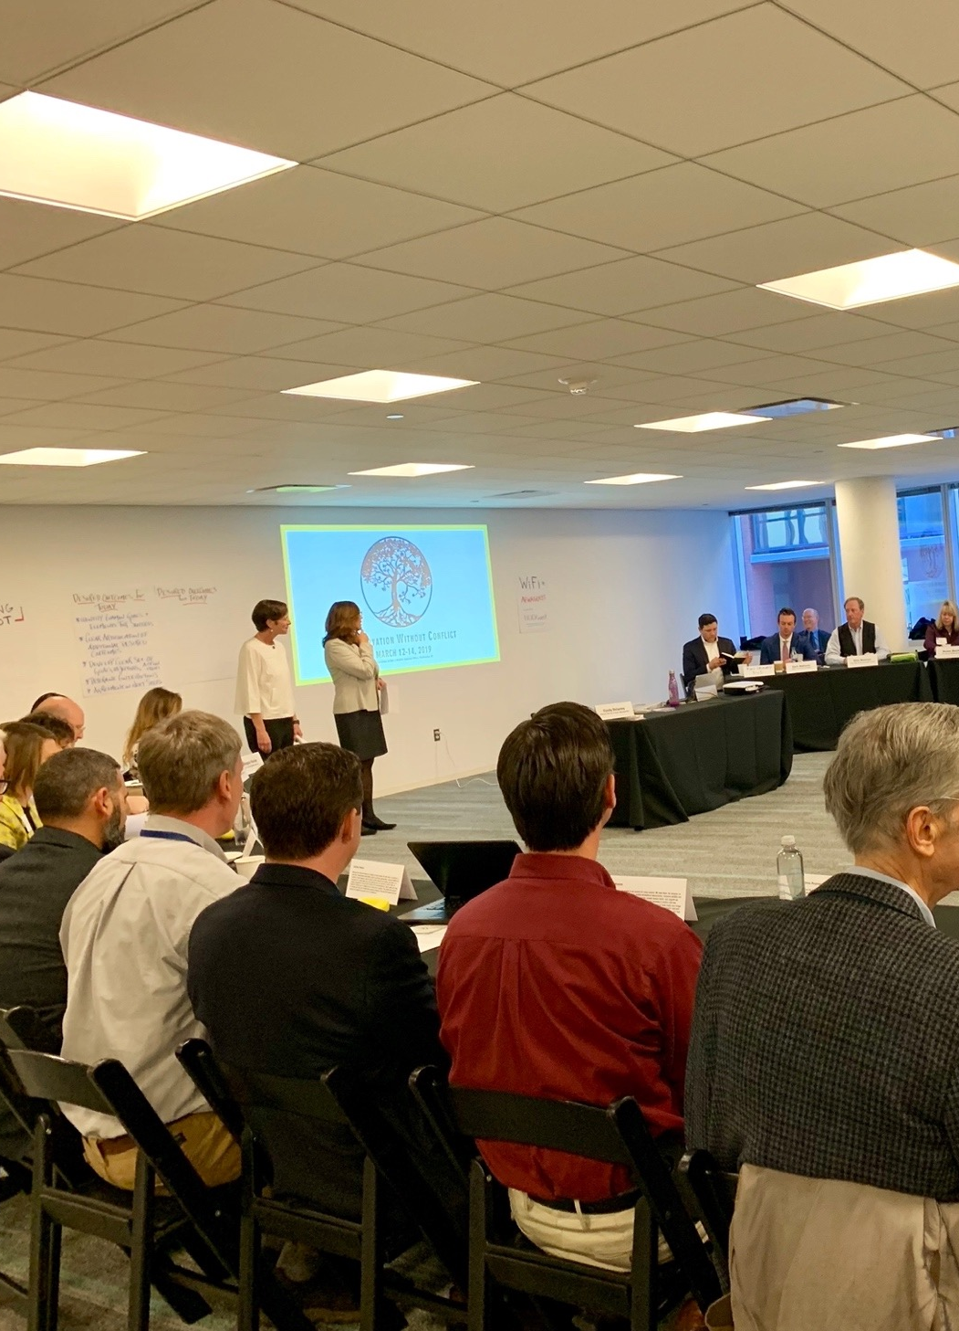

OUR MISSION
Foster a culture of enduring trust and partnership across diverse sectors, groups, and individuals to support a sustainable national landscape that conserves wildlife, keeps working lands working, and improves quality of life for landowners and communities.

Slide 7


Our Operating Principles
Growing paradigm shift for wildlife conservation
Voluntary & collaborative
Building enduring trust
Diverse & inclusive
Embracing science & innovation
Increasing predictability & economic viability
Sustainable and scaled
Capitalizing on flexibility of ESA

Slide 8













Benefits of the Conservation Without Conflict Approach
Thriving wildlife & increasing biodiversity
Ecological co-benefits
Keeping working lands working
Socioeconomic & cultural
co-benefits
More adaptable, efficient, & effective projects
Cultural
co-benefits

Slide 9


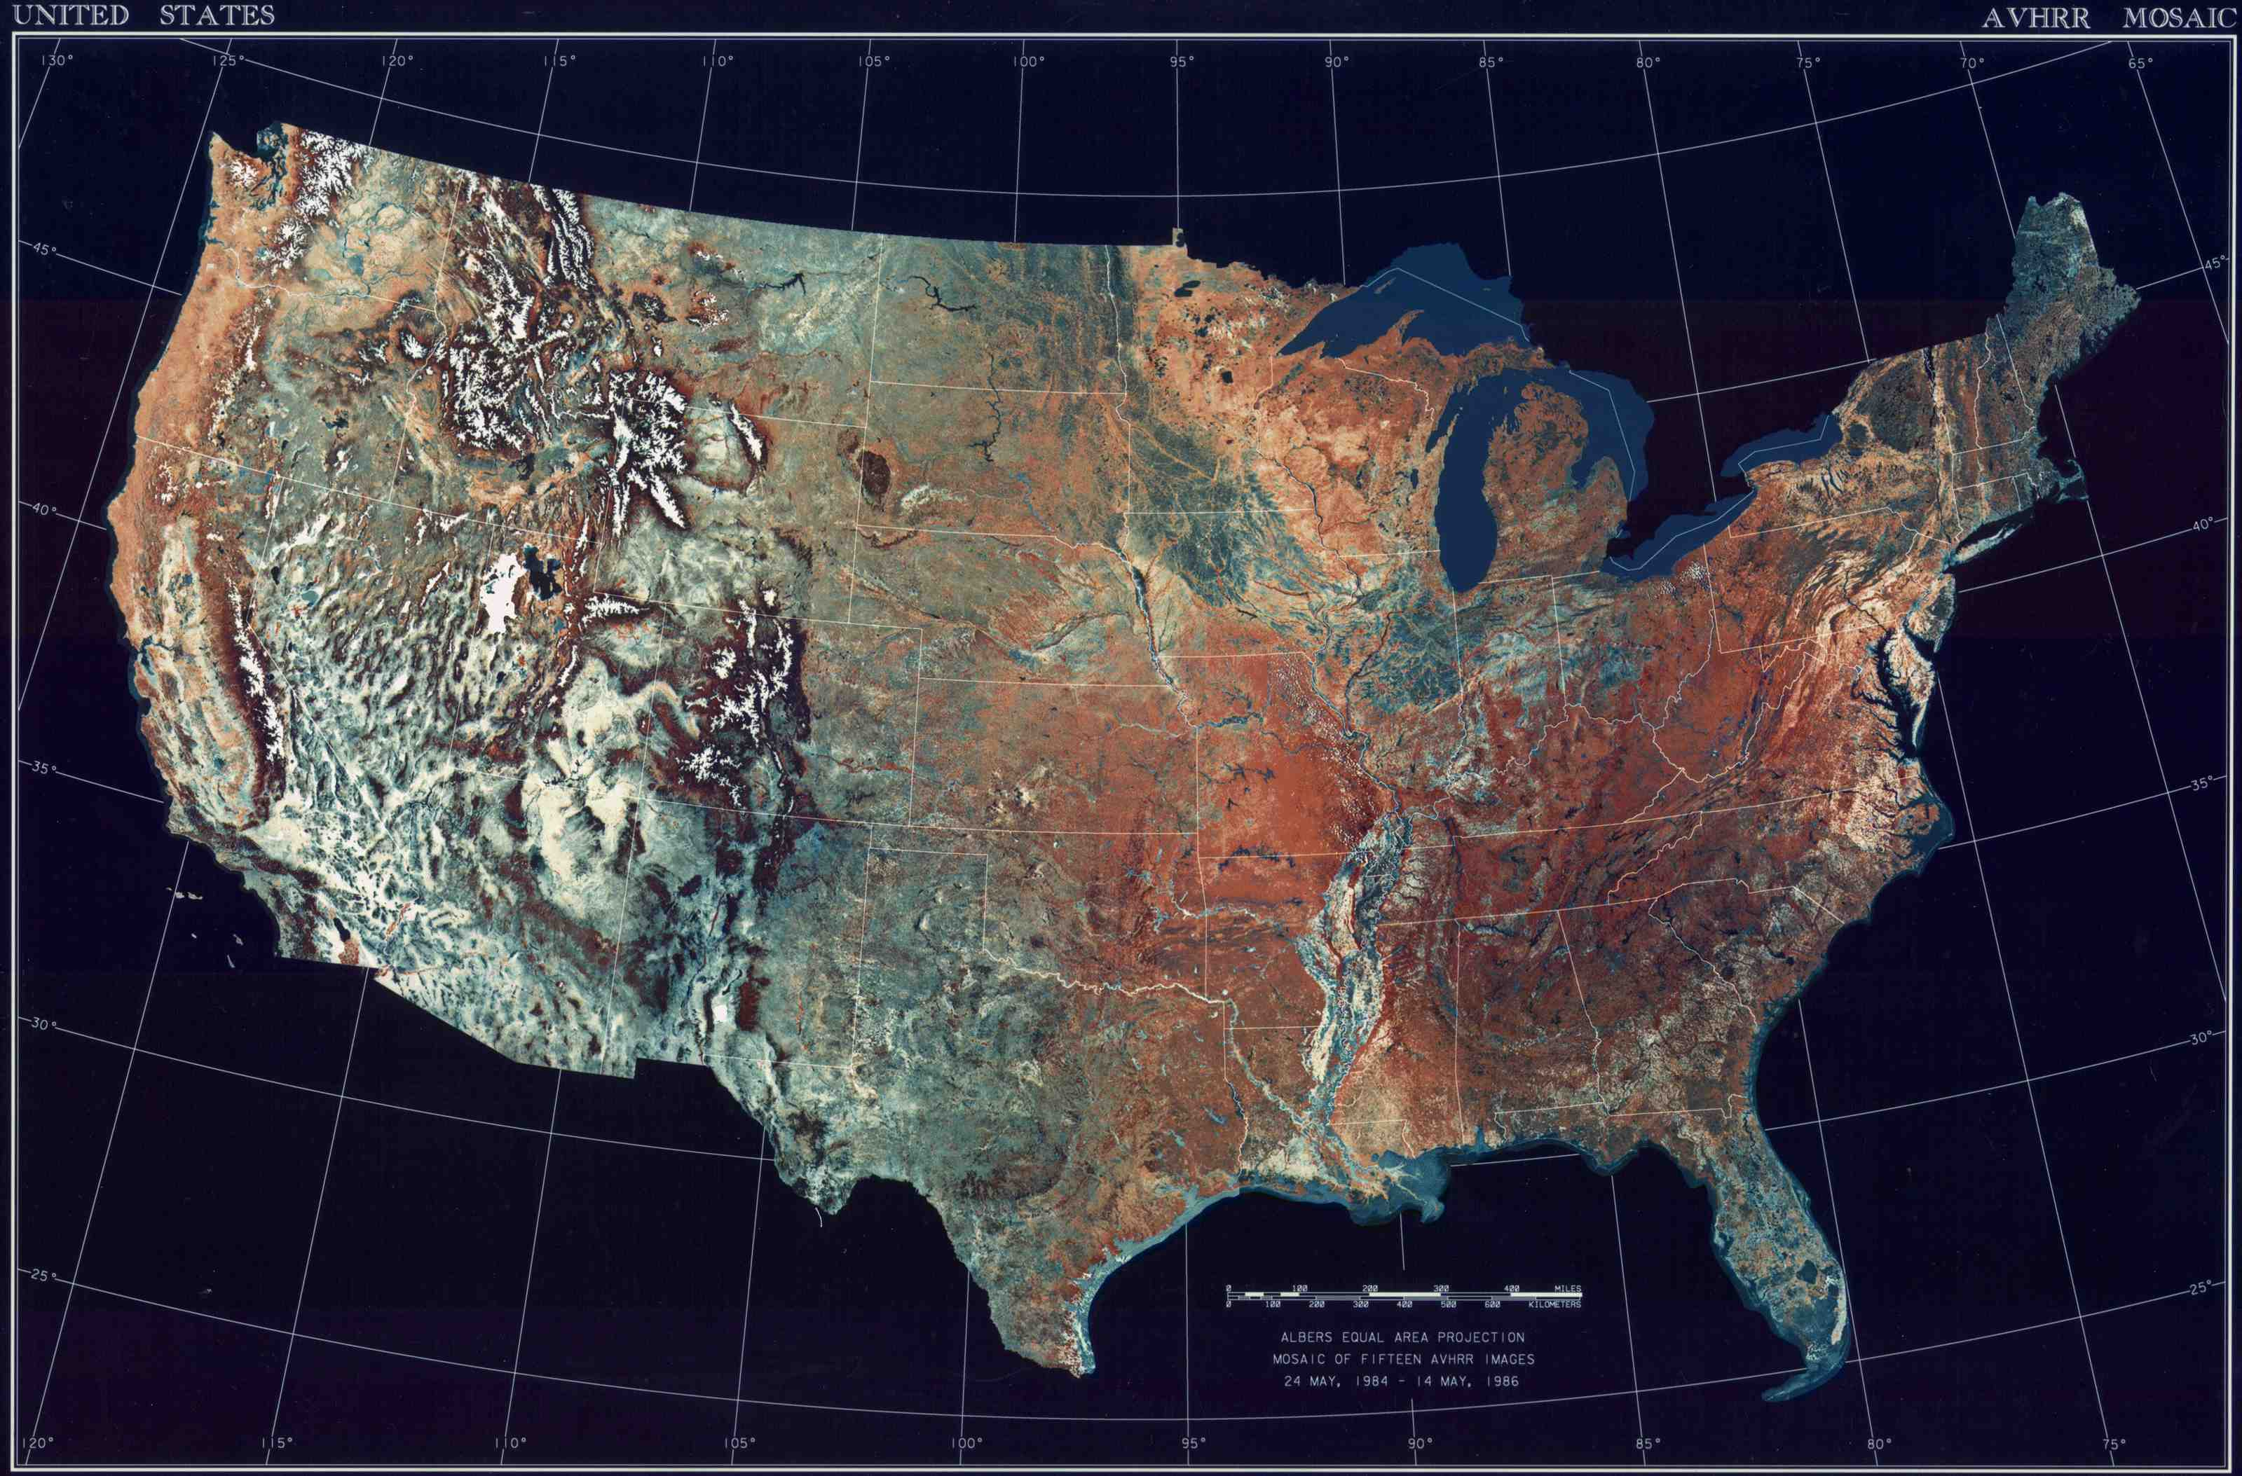
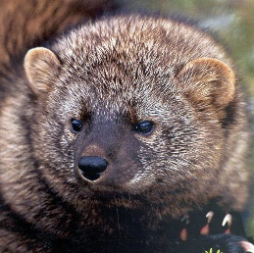

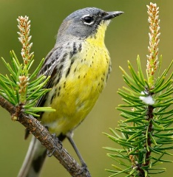
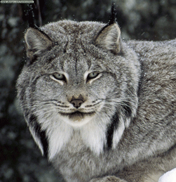
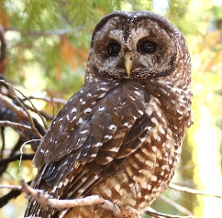
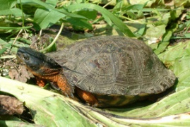
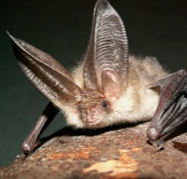
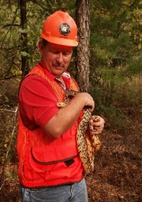
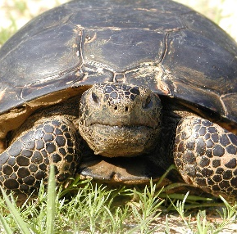
A FEW CONSERVATION WITHOUT CONFLICT EXAMPLES

Slide 10
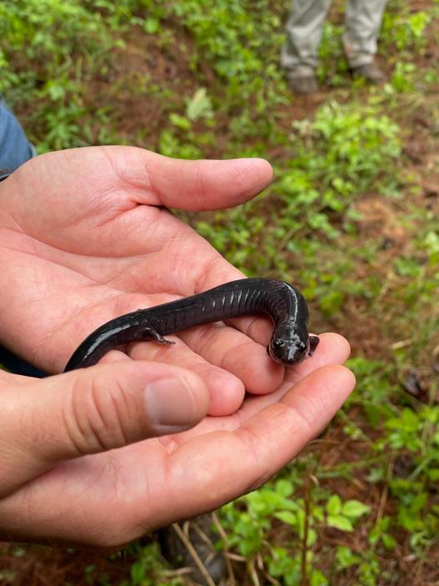
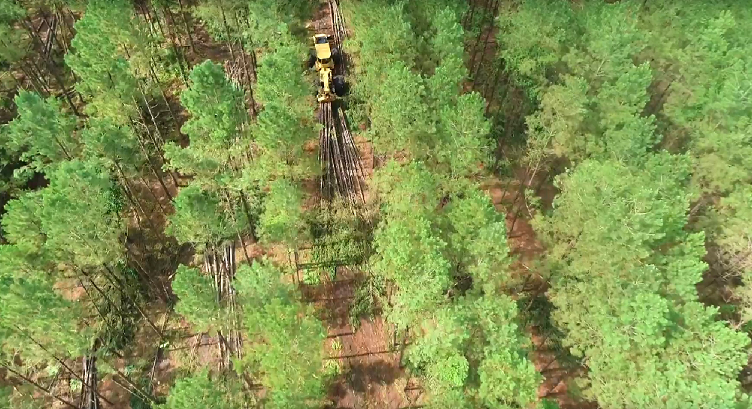
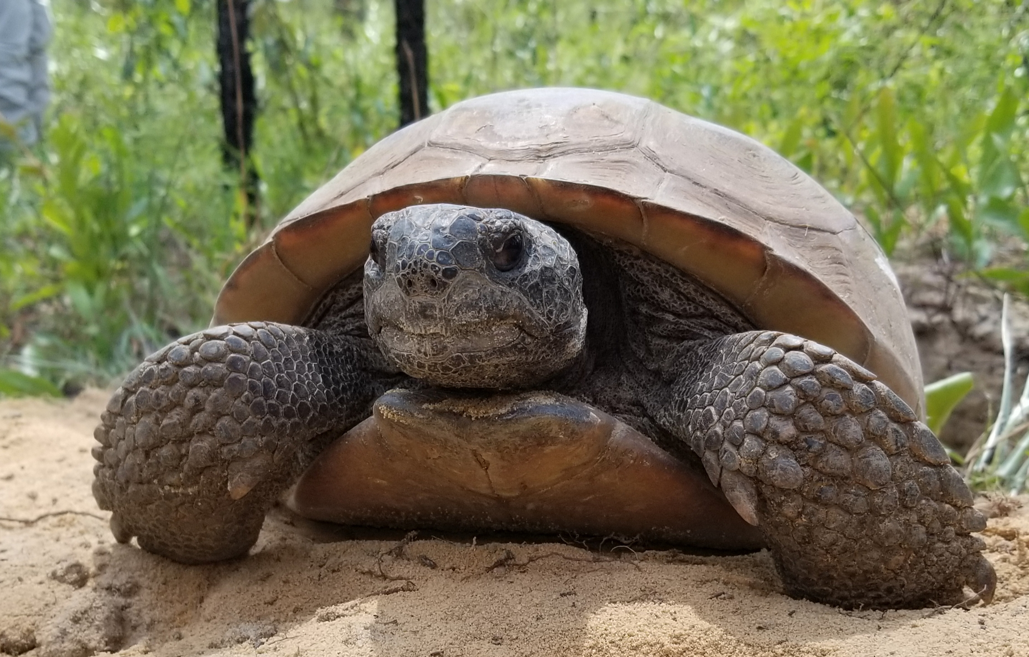
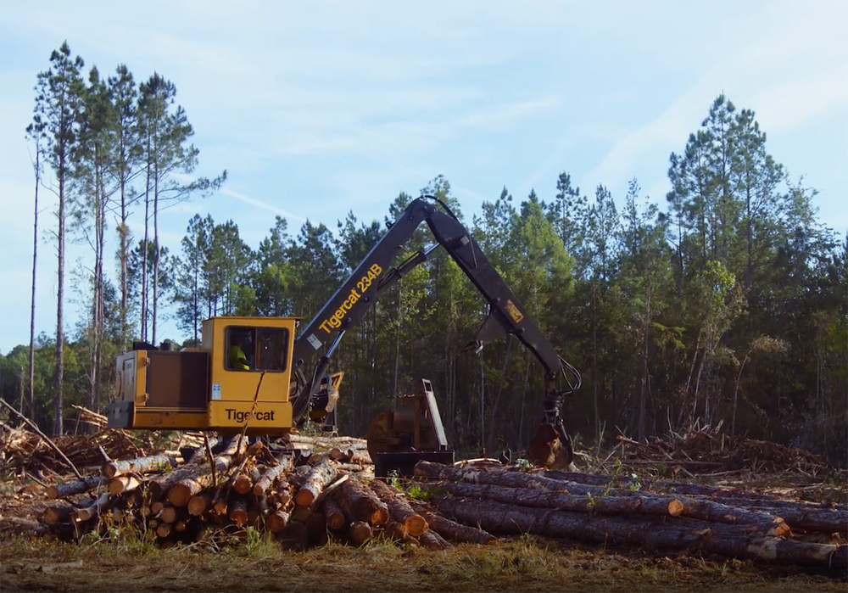
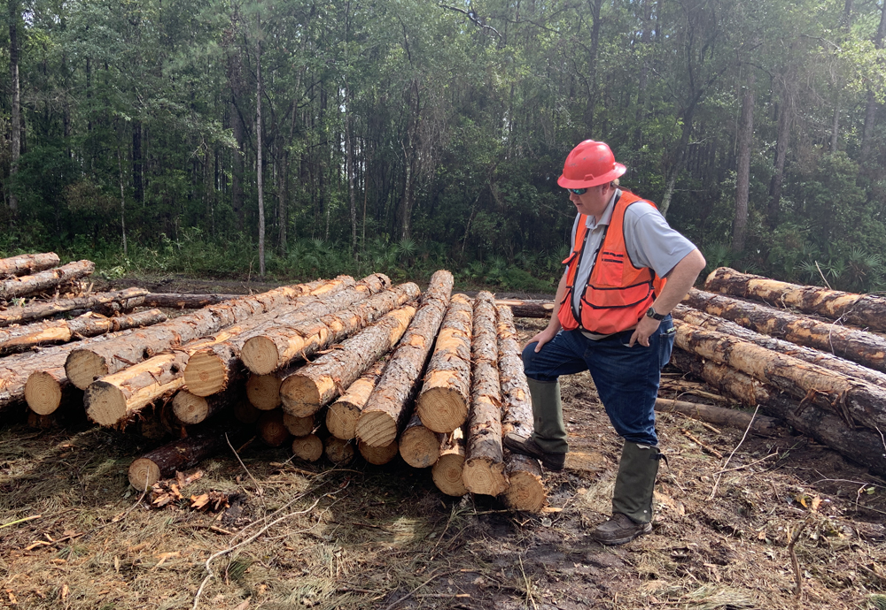
A cultural sea change in how conservation happens on private lands
The path forward for conservation of at-risk and listed species, and…
…Keeping working lands working

Slide 11

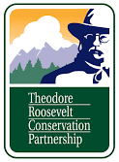









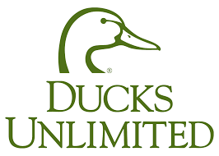
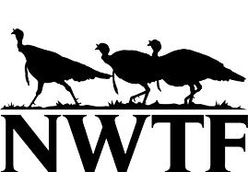
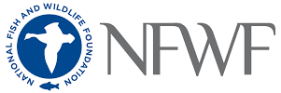







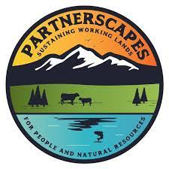


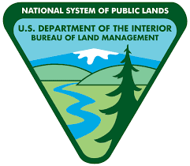
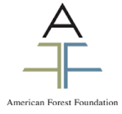

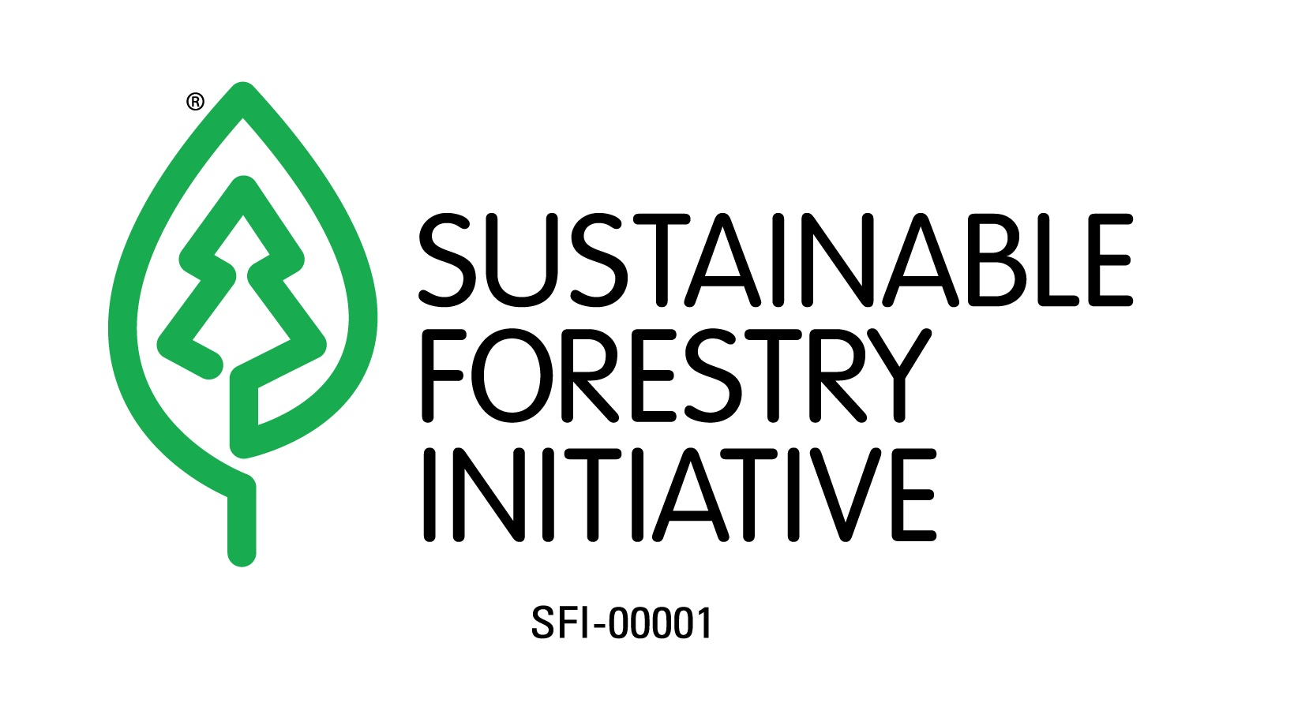
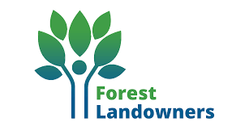





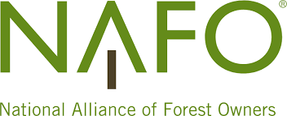


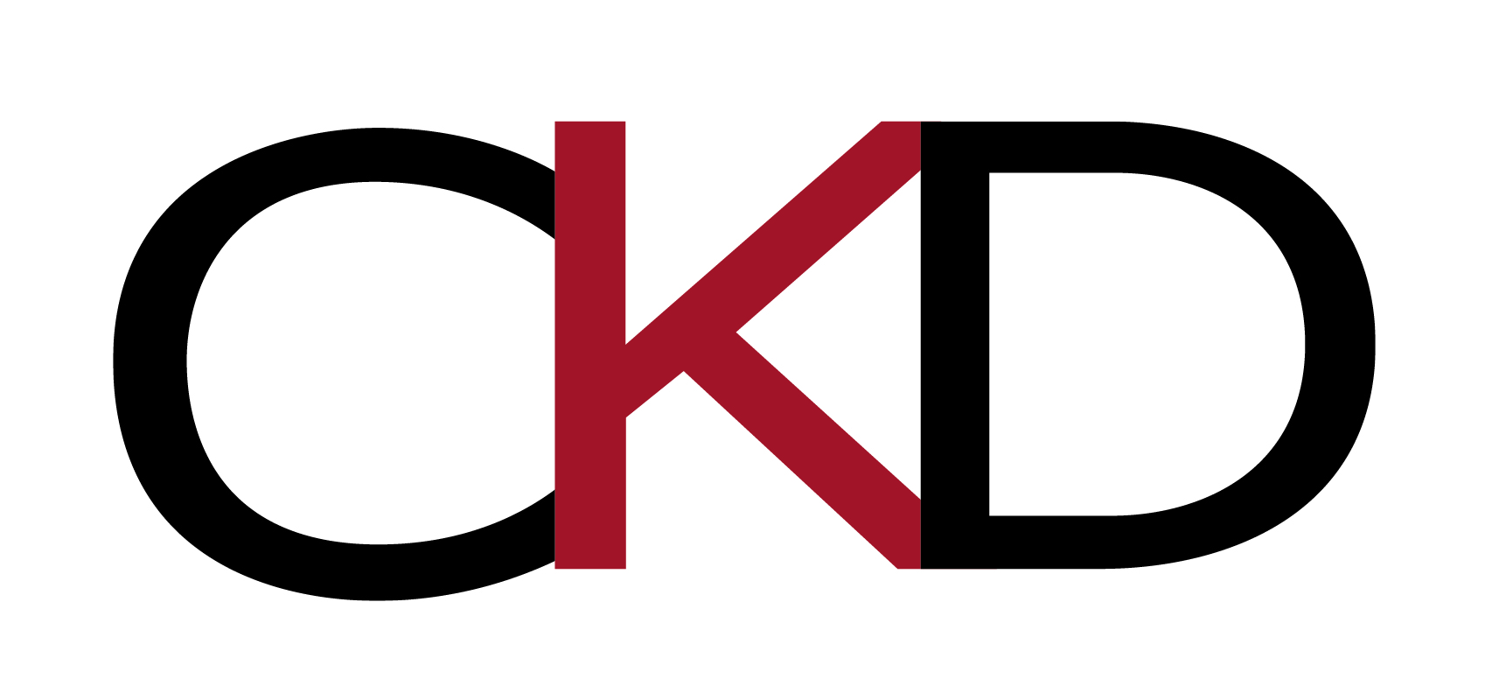
Our Coalition Members

Slide 12
THANK YOU!
Visit
www.ConservationWithoutConflict.org
email
Leo@ConservationWithoutConflict.org
Call
470-346-7392

