Slide 1


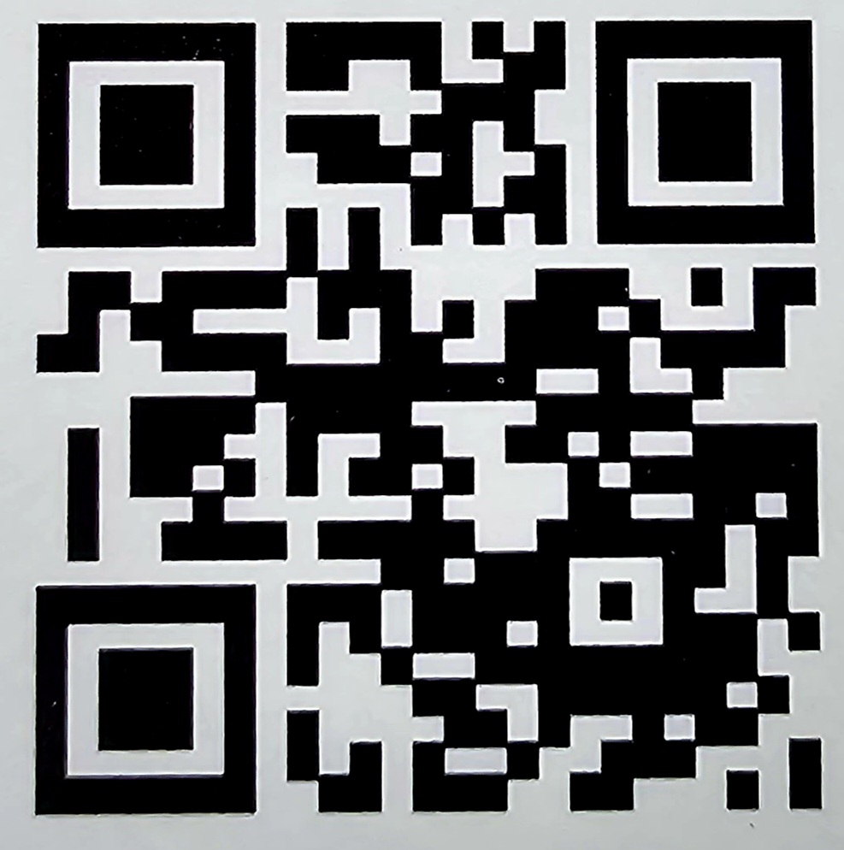
A proven approach for wildlife conservation on working lands
February 14, 2024

Slide 2


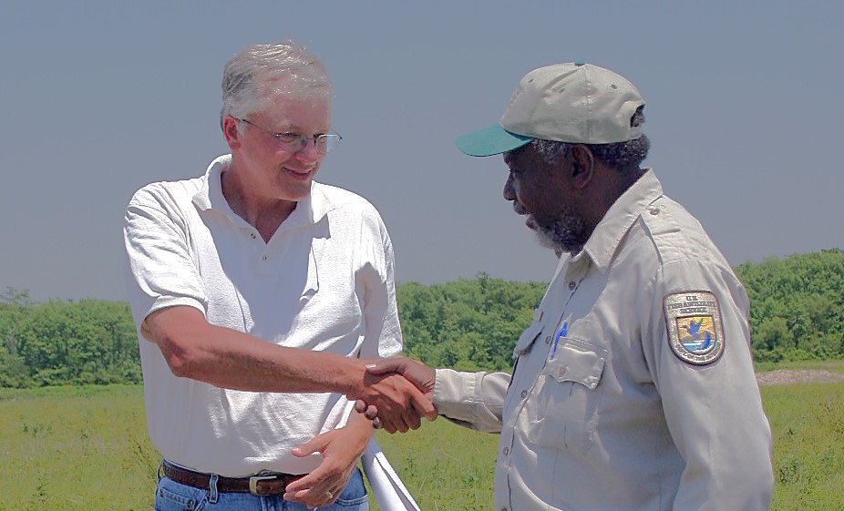
A concept and a coalition that frames a collective vision of voluntary collaboration with working forests, farms and ranches
The culture for voluntary collaboration across diverse sectors and groups
Working landscapes integral to success
Mutually beneficial conservation and economic sustainability at scale

Slide 3


What is Conservation Without Conflict?
Conservation Without Conflict is both a proven approach to conservation and a coalition of public and private partners with highly diverse goals who are united in their commitment to conserving wildlife while keeping America’s working lands working. Our coalition emphasizes:
INNOVATIVE VOLUNTARY COLLABORATIVE
approaches to conserving wildlife on working lands, rather than the historically contentious – and even litigious – approaches of the past.
Together, we are establishing an enduring cultural shift across diverse stakeholder groups, yielding a transformational change in the way we achieve conservation.

Slide 4
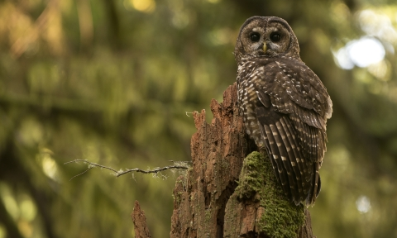
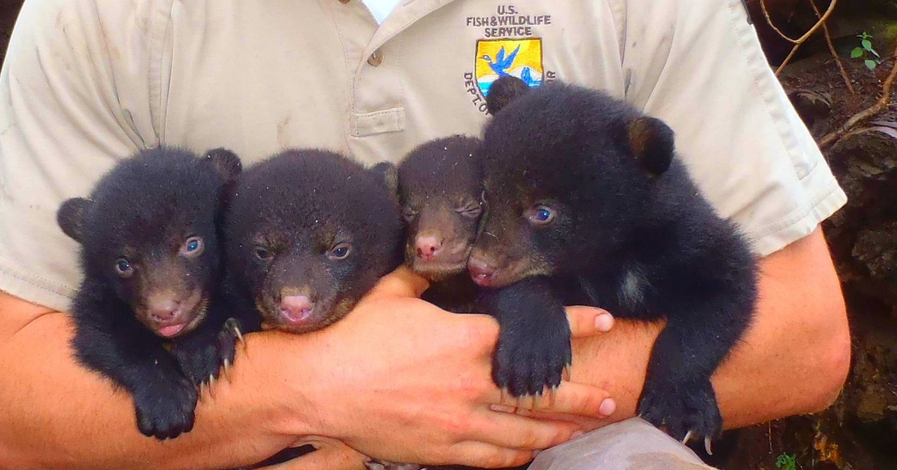
Conservation Without Conflict can be traced back to 1990!
June 21, 1990 Louisiana black bear threatened listing proposed
June 23, 1990
Northern spotted owl
listed as threatened

Slide 5
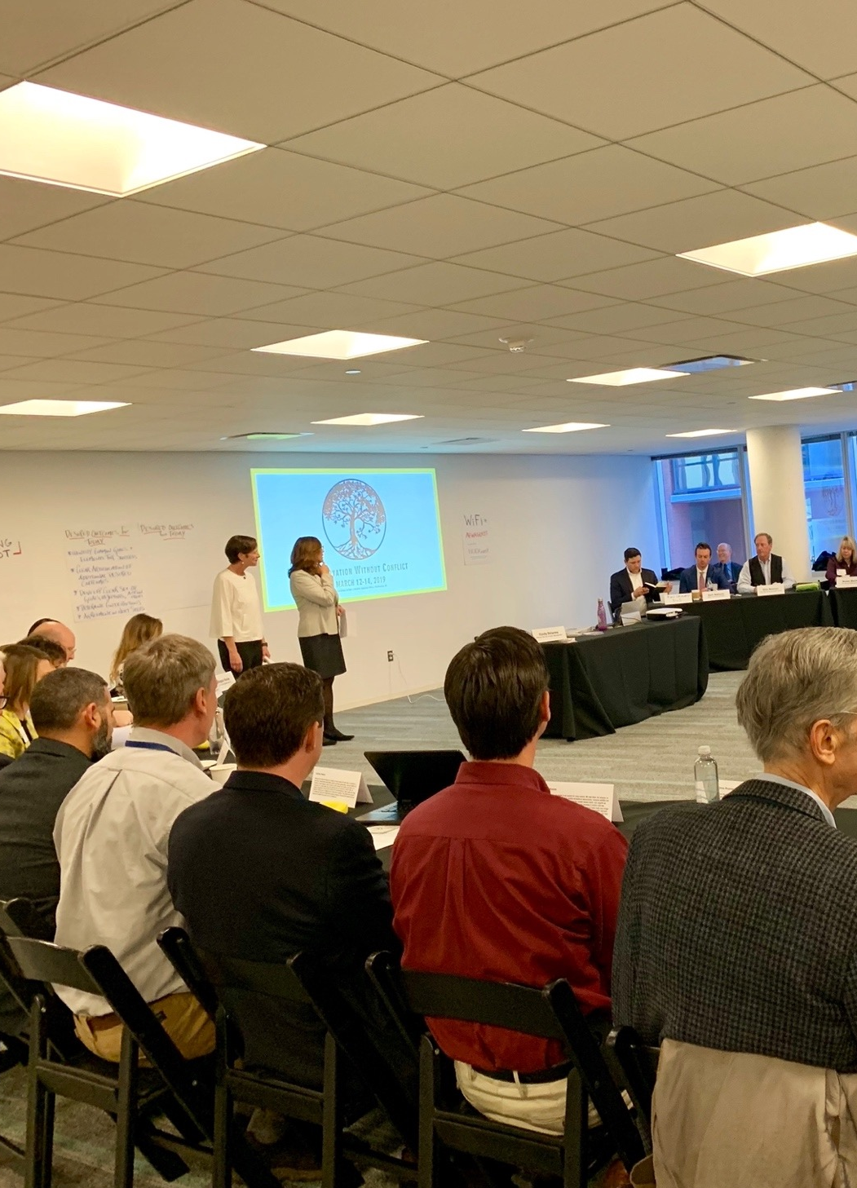

OUR MISSION
Foster a culture of enduring trust and partnership across diverse sectors, groups, and individuals to support a sustainable national landscape that conserves wildlife, keeps working lands working, and improves quality of life for landowners and communities.

Slide 6

























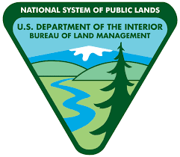













Our Coalition Members

Slide 7


Effective conservation without conflict involves several important steps:
Embrace the local context
Empower meaningful engagement and participation
Clarity of purpose: Unite around shared goals
Implement adaptive management strategies
Foster sustainable livelihoods and conservation
Build capacity and empower landowners and communities
Establish collaborative governance mechanisms
Cultivate continuous communications and learning

Slide 8




A Simple Model for Success!
=
Outcomes
Habitat Species Collaboration

Slide 9
THANK YOU!
Visit
www.ConservationWithoutConflict.org
email
Leo@ConservationWithoutConflict.org
Call
470-346-7392

