Slide 1
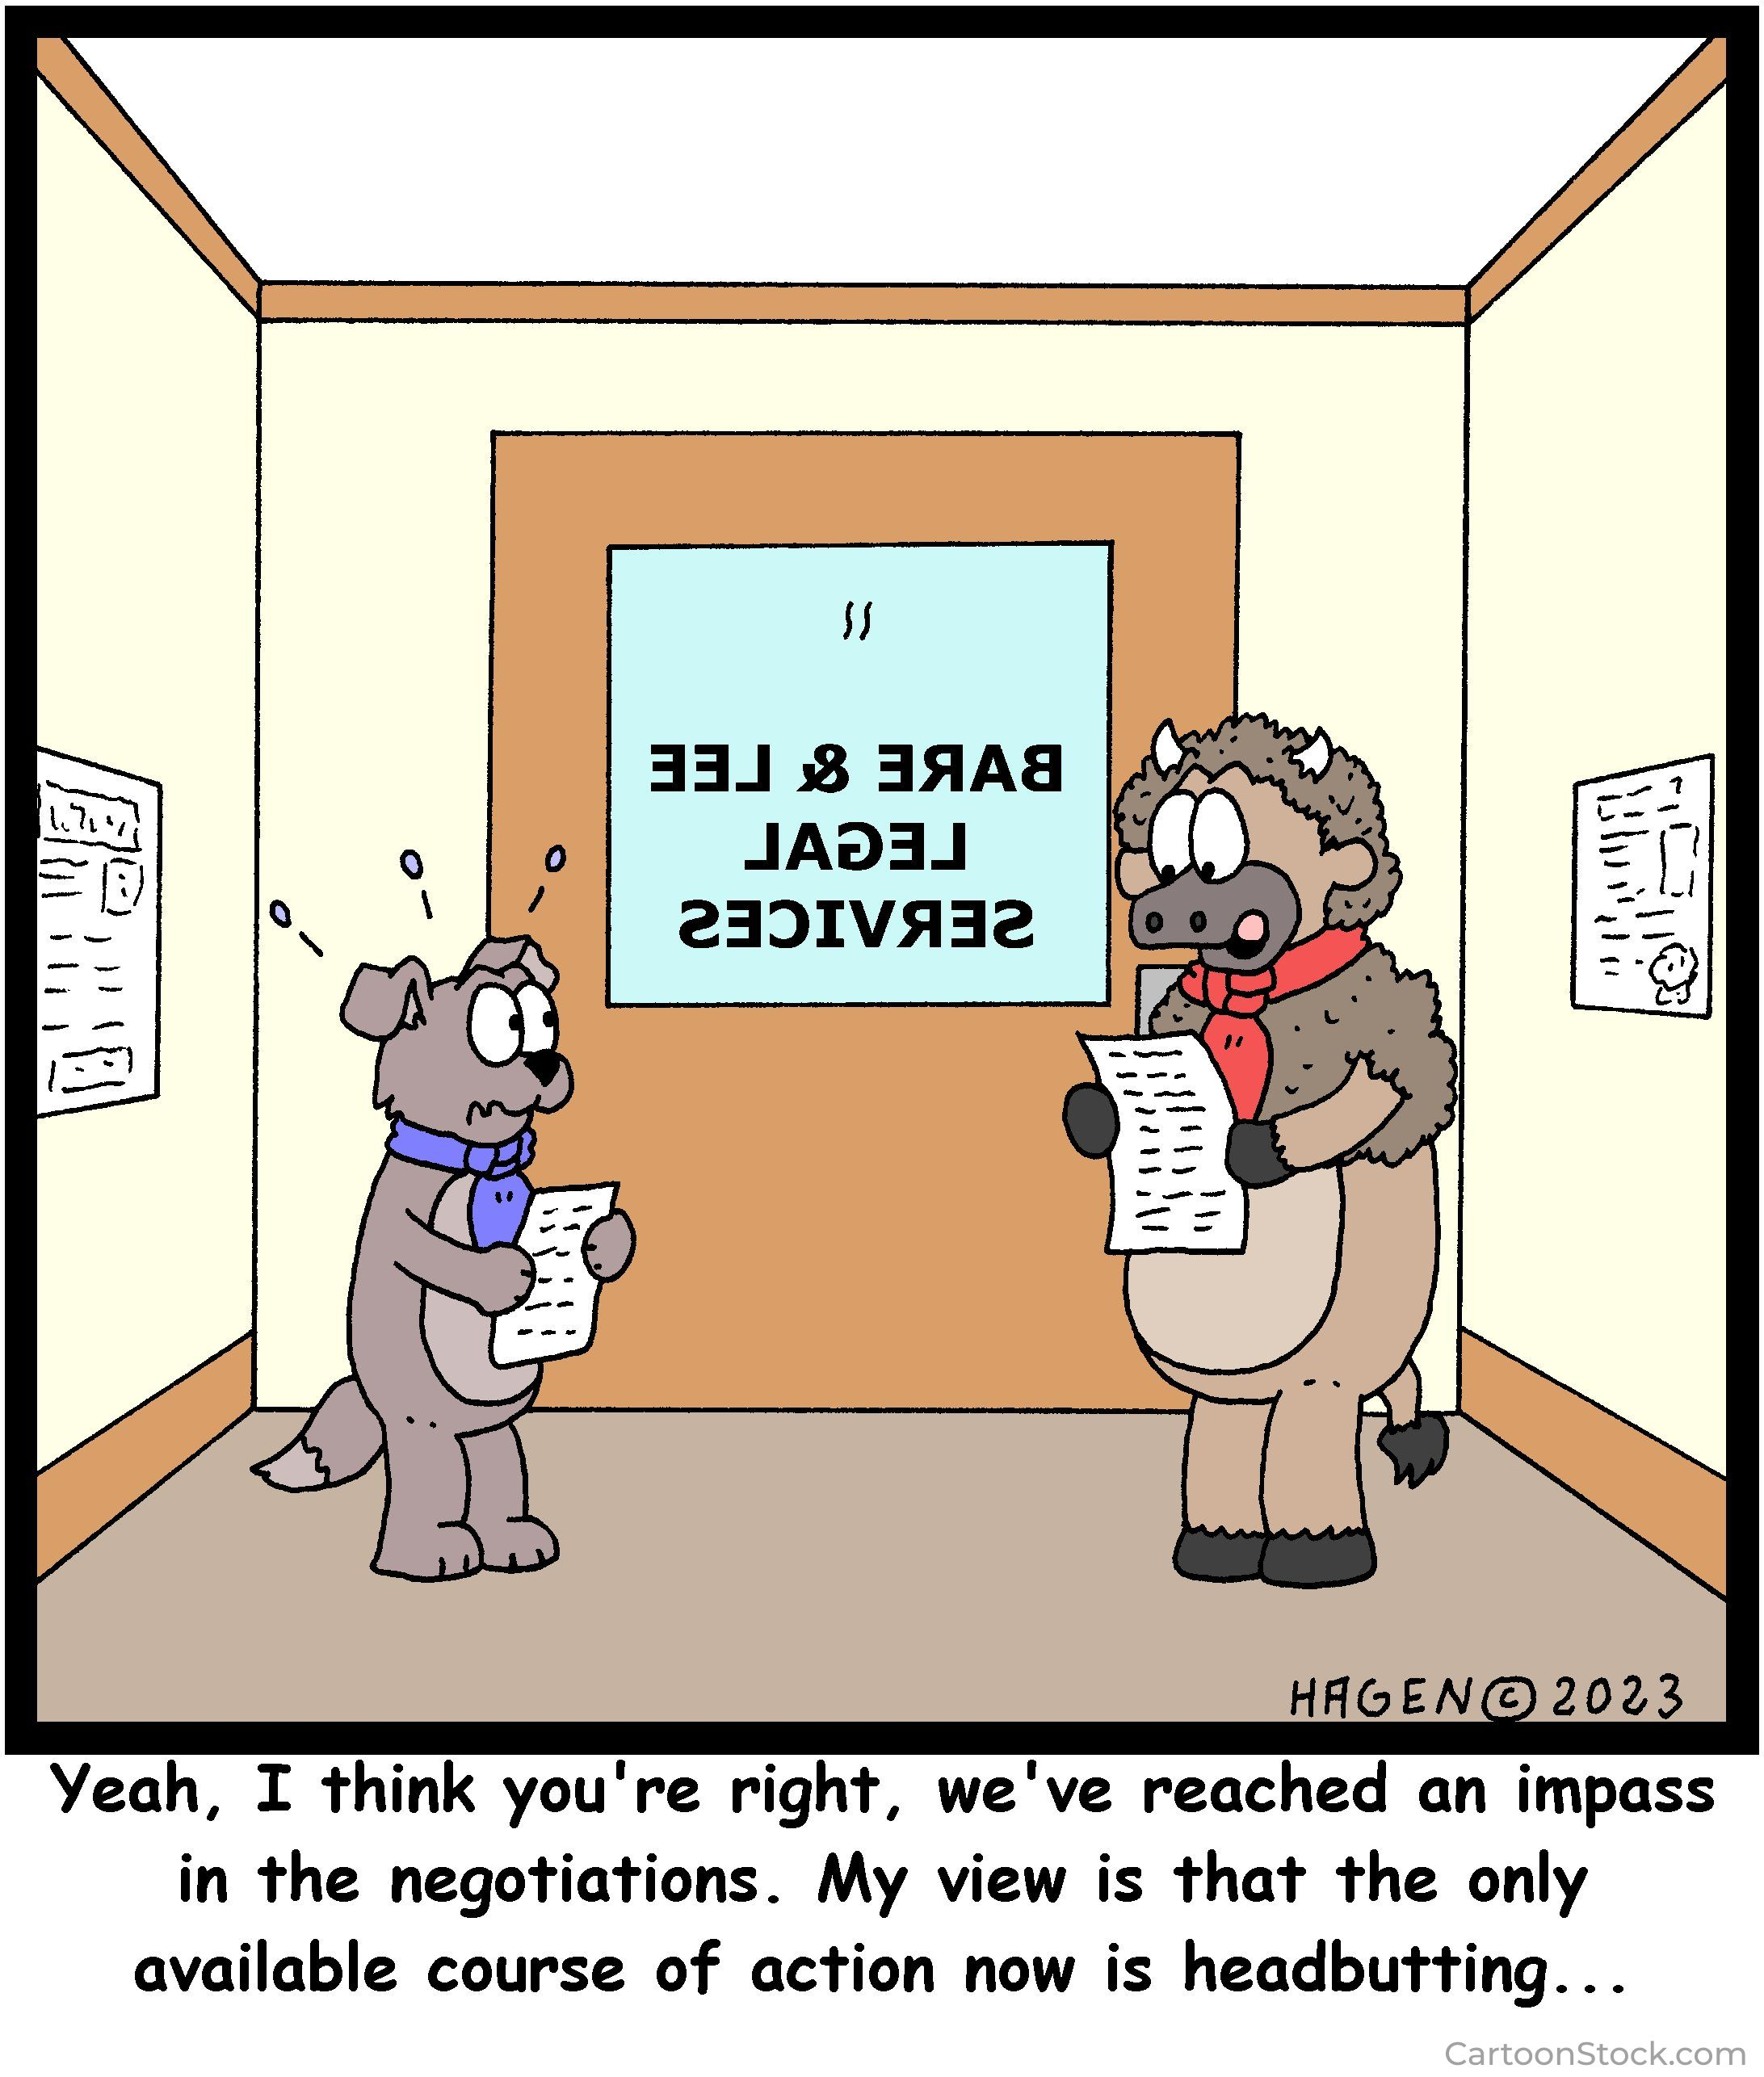
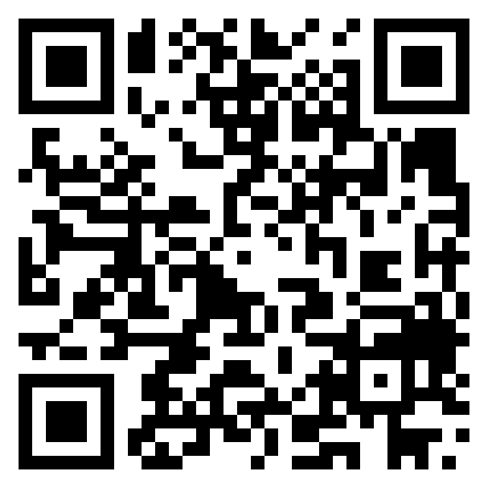

Slide 2
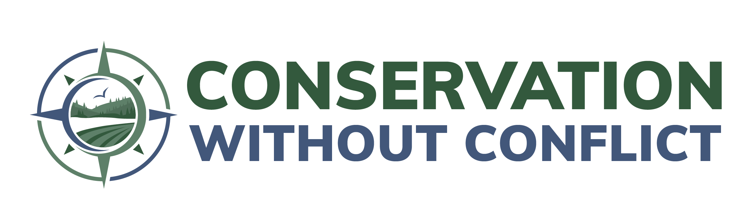

Working CONFLICT Out!
Leo Miranda-Castro
Executive Director
2025 Texas Chapter of
The Wildlife Society Conference
Denton, TX
Feb. 19 2025

Slide 3
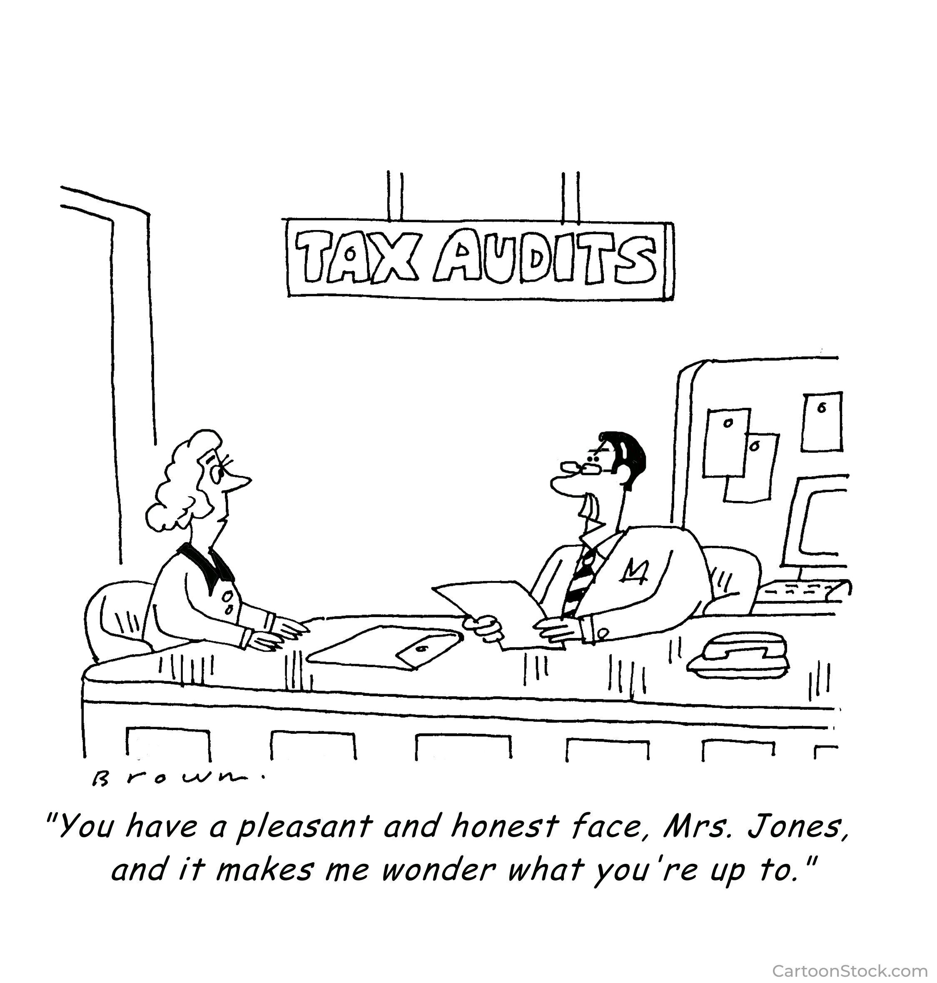

Slide 4
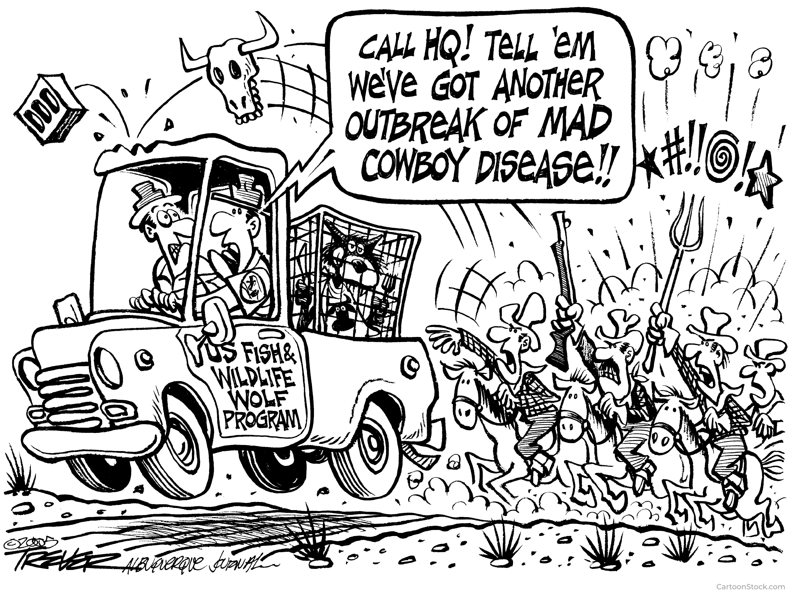

Slide 5

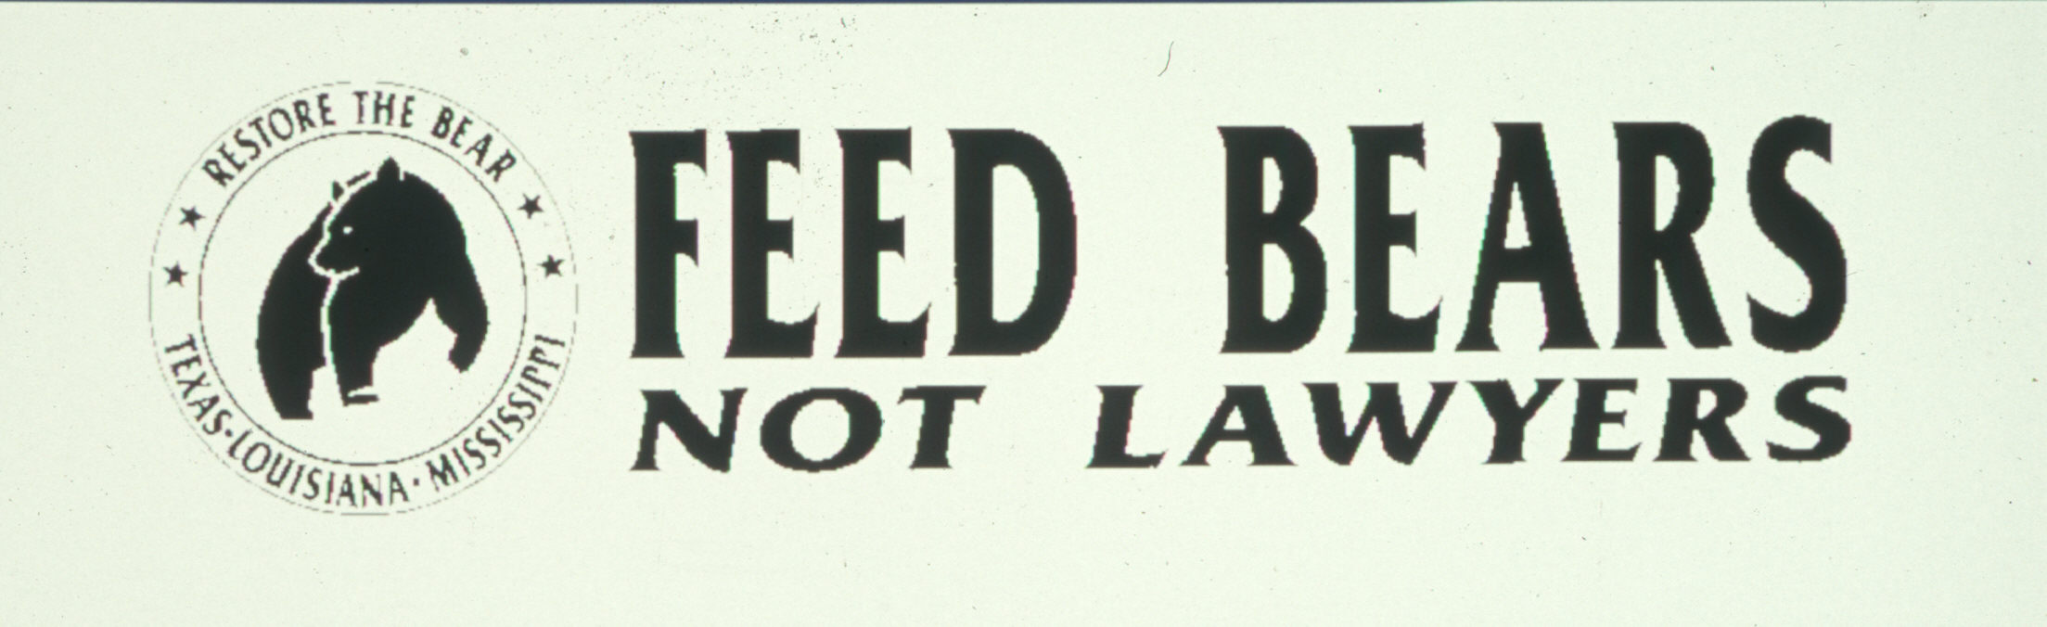
“We Must Remove the Profit from Conservation Conflict"

Slide 6
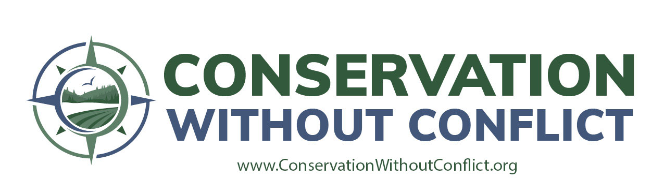
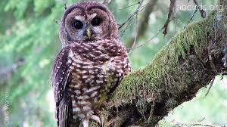
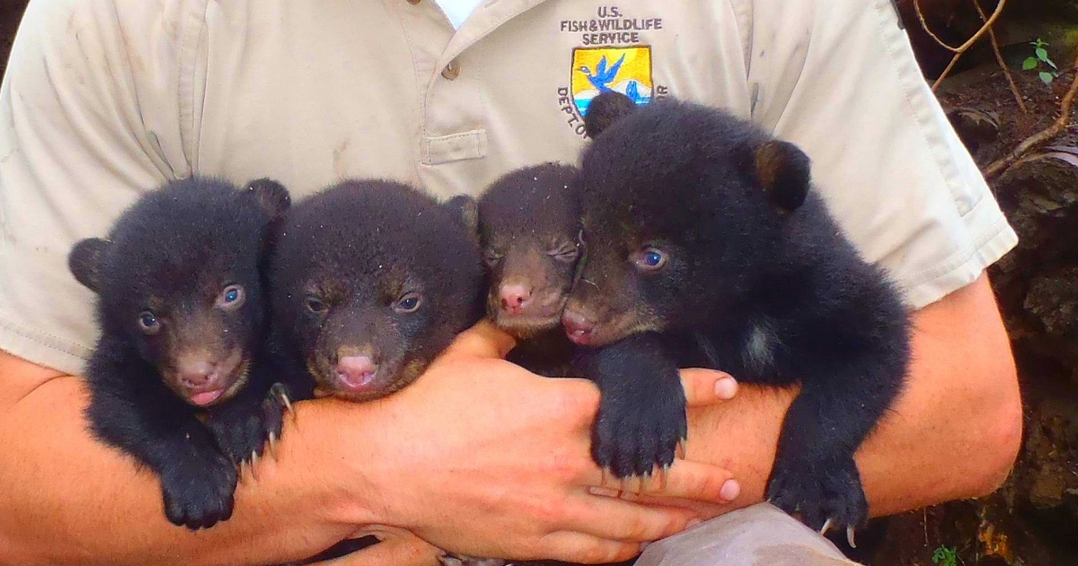
It doesn’t need to be this way!
ESA Seminal Events June 1990
June 23, 1990
Northern spotted owl
listed as threatened
June 21, 1990 Louisiana black bear threatened listing proposed

Slide 7
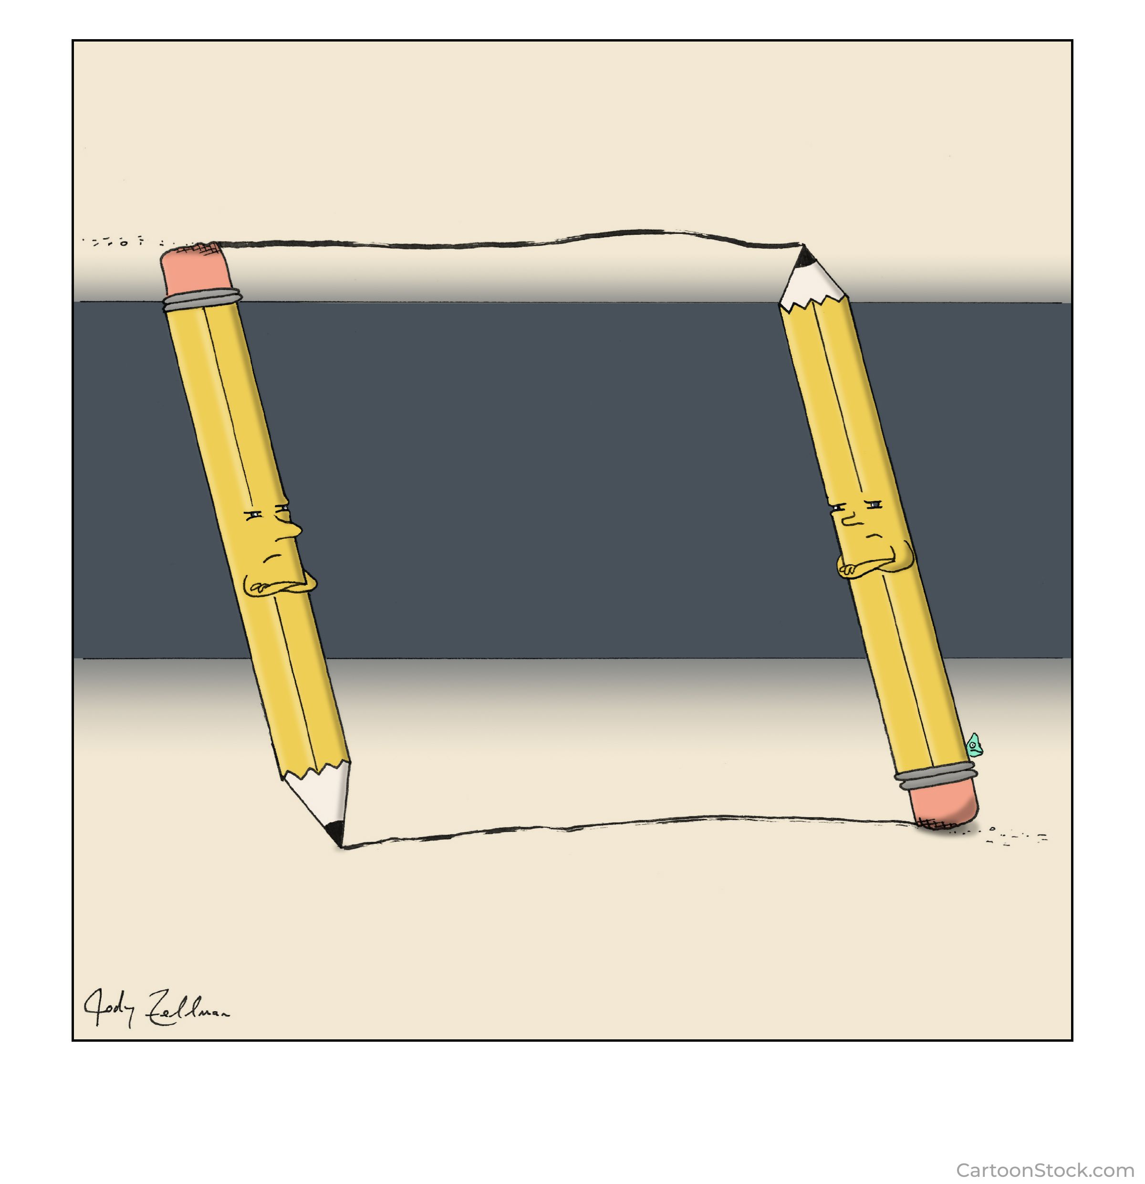
What’s the definition of
INSANITY?

Slide 8
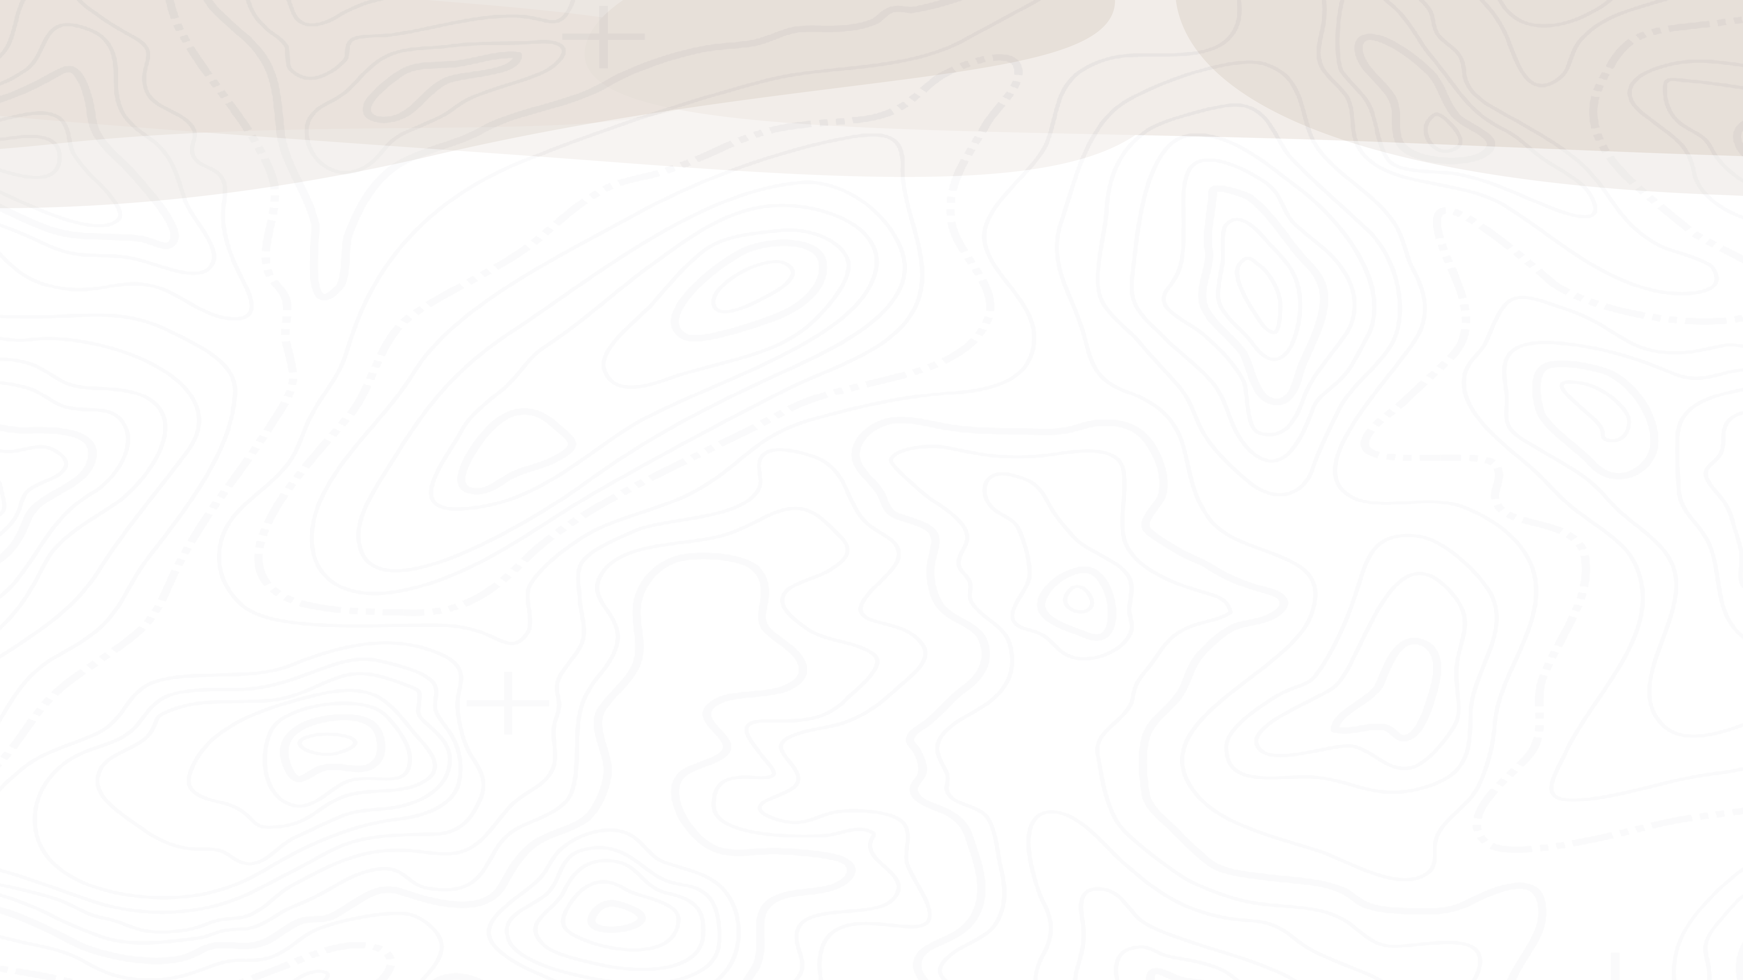












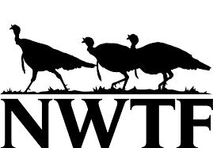



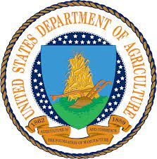







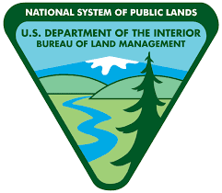


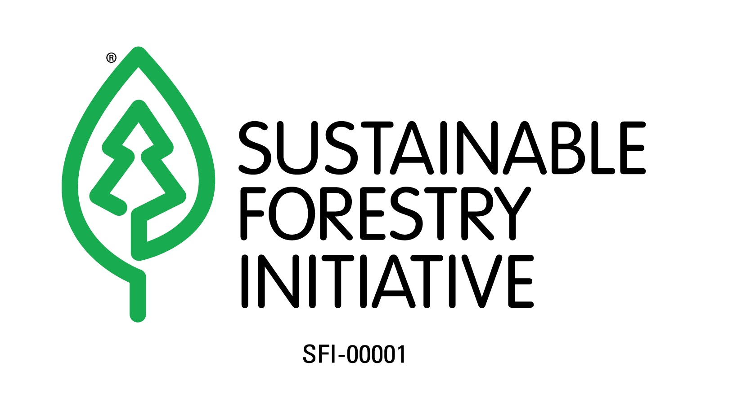









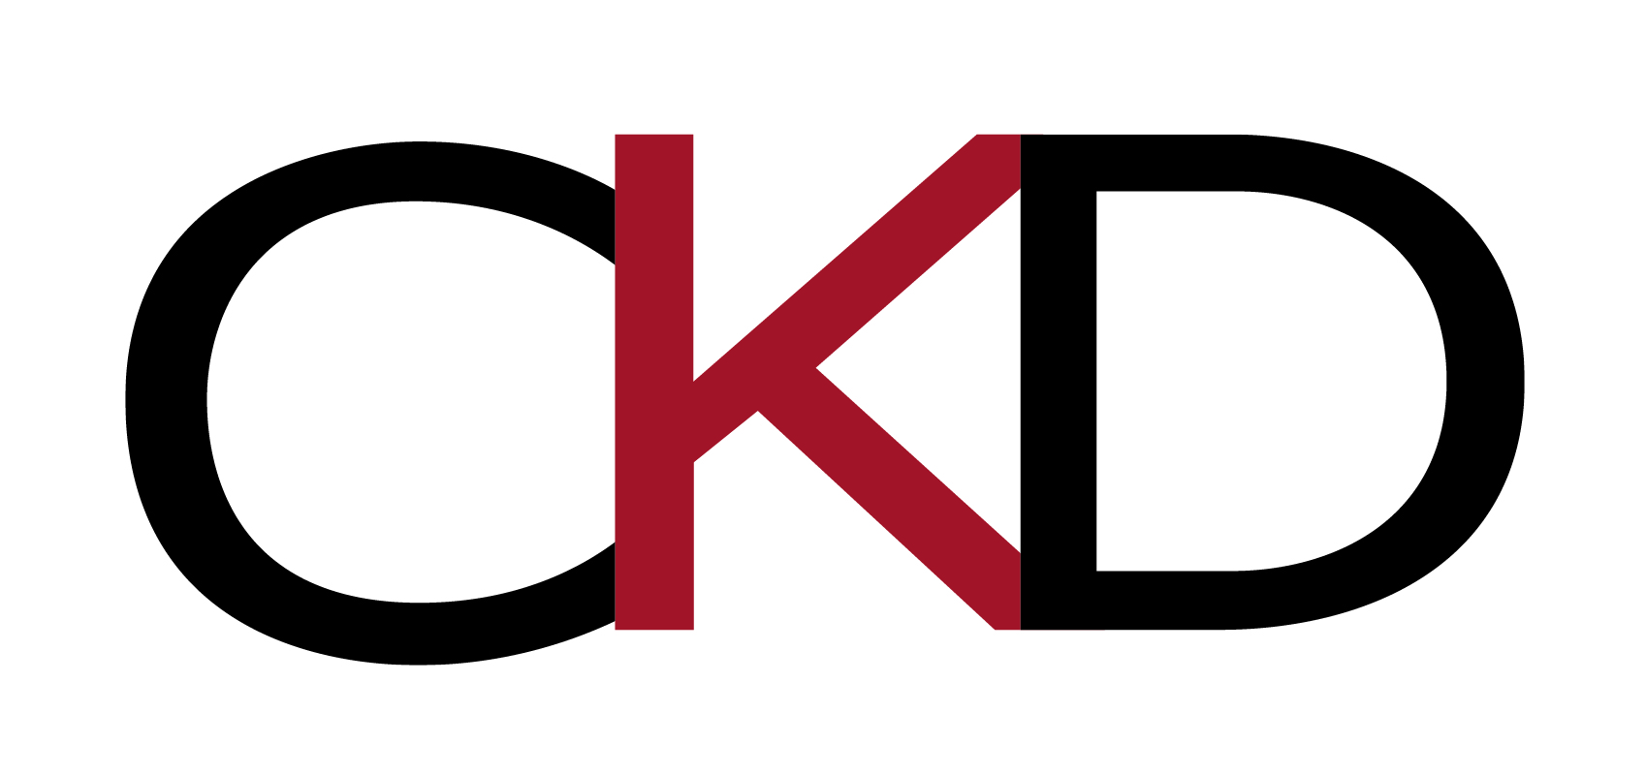
Coalition Members

Slide 9
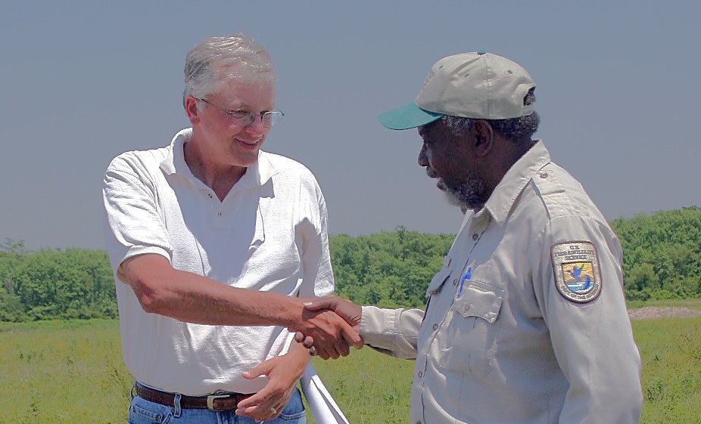
A concept and a coalition that frames a collective vision of voluntary collaboration with working forests, farms, ranches, military and all industries with a land management footprint.
The culture for voluntary collaboration across diverse sectors and groups.
Mutually beneficial conservation and economic sustainability at scale.

Slide 10
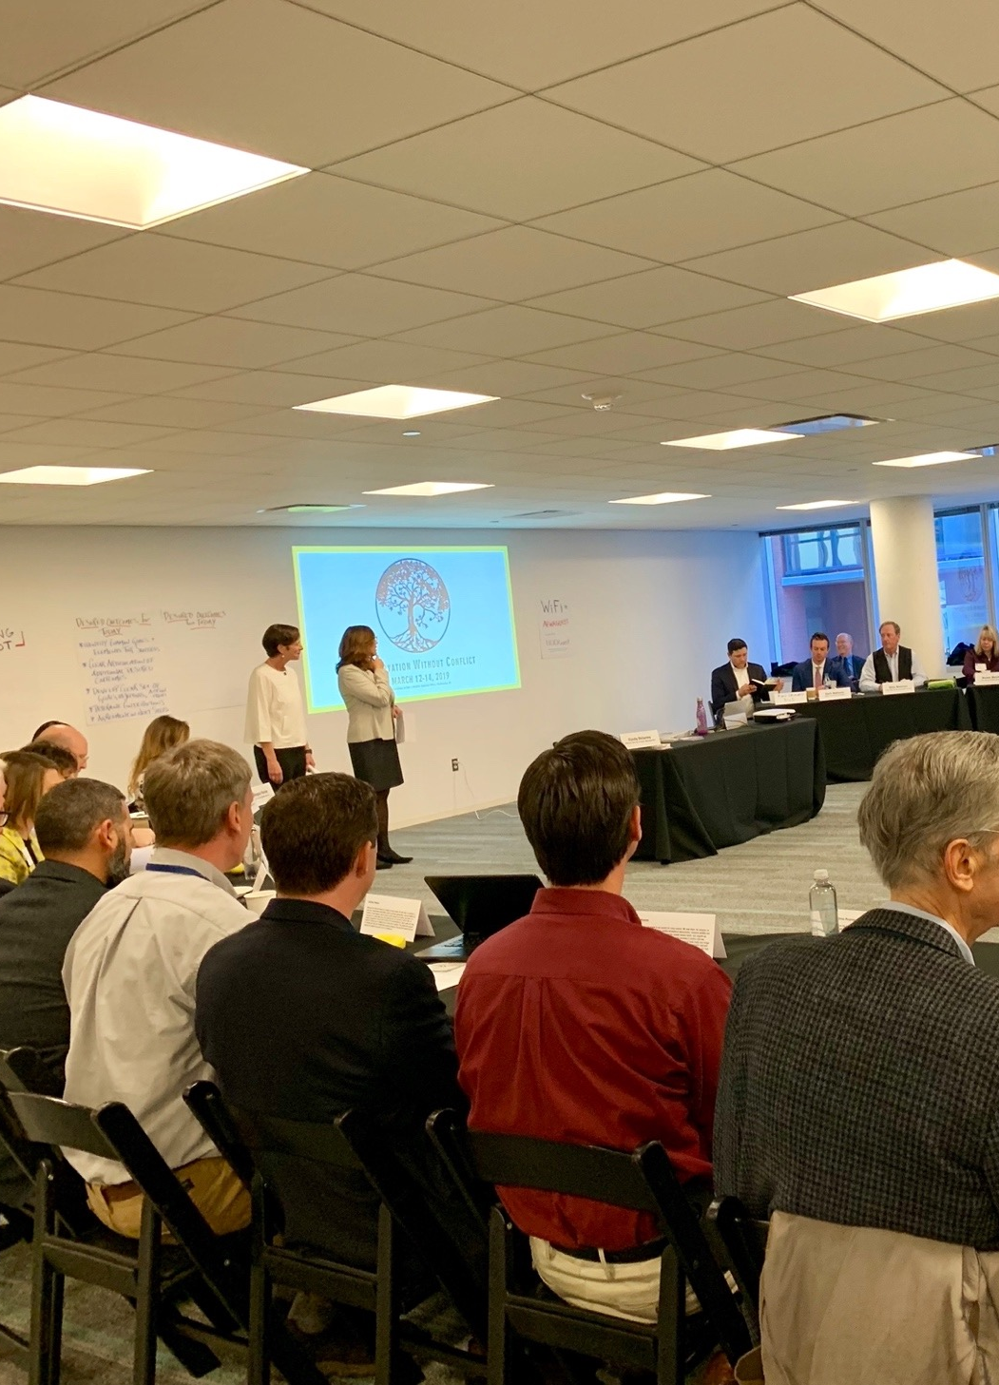

OUR MISSION
We want to foster a culture of enduring trust and partnership across diverse sectors, groups, and individuals to support a sustainable national landscape that conserves wildlife, keeps working lands working, and improves quality of life for landowners and communities.

Slide 11
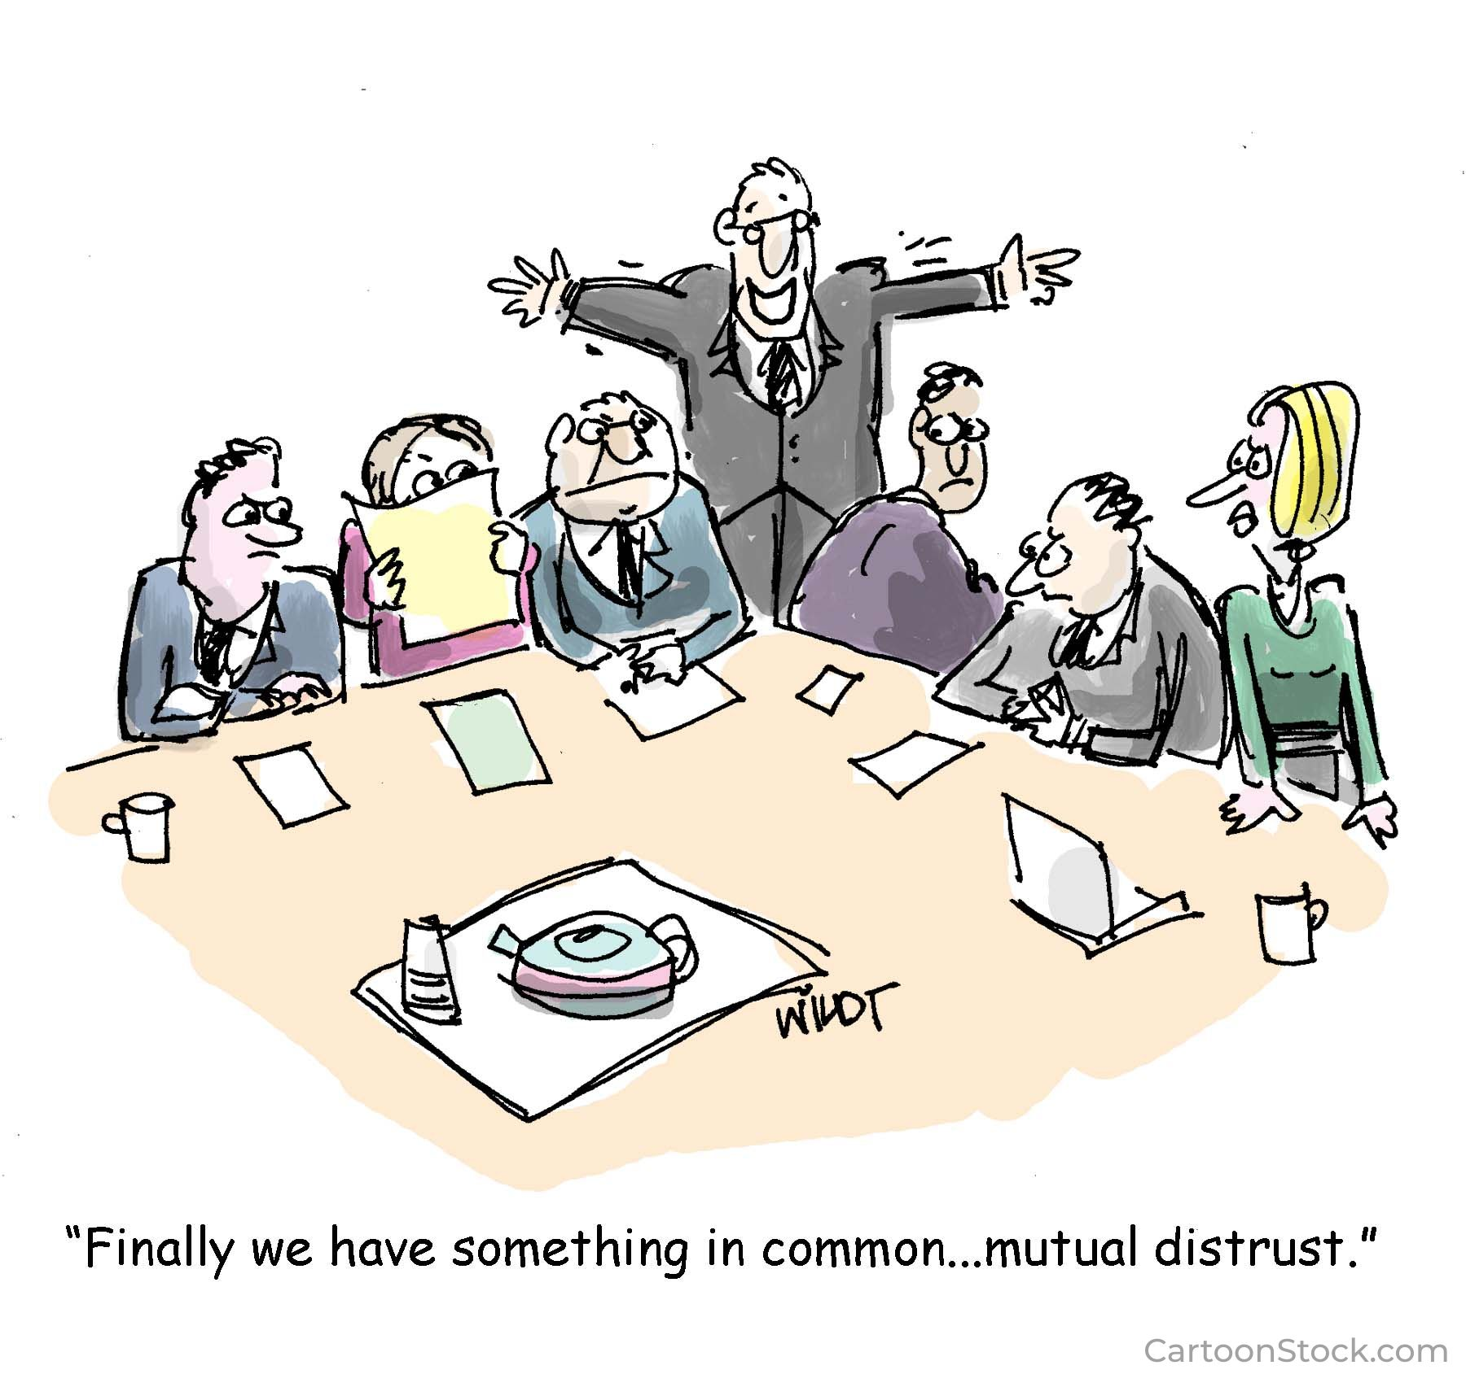
  We advocate for voluntary collaboration as the preferred model for wildlife conservation on working lands across the United States.
  Building a culture of trust and collaboration as opposed to a “us-versus-them” mentality is critical.
  There is a clear expectation for the Coalition to find innovative solutions that get implemented.

Slide 12

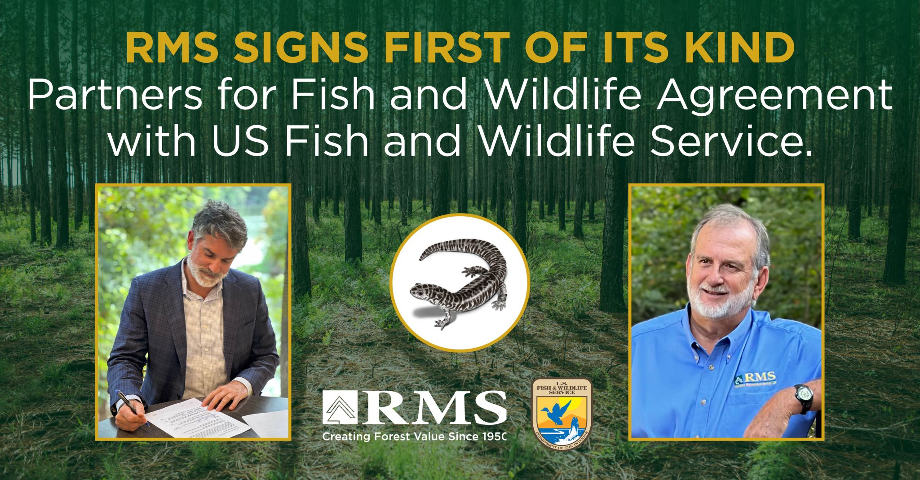
Innovation in collaborative conservation
Work together to embrace current and create new innovative conservation tools:
  Identify and replace disincentives.
  Simplify existing incentives.
  Recognize no separation between natural & social sciences, policy or the urgency of our respective missions.

Slide 13
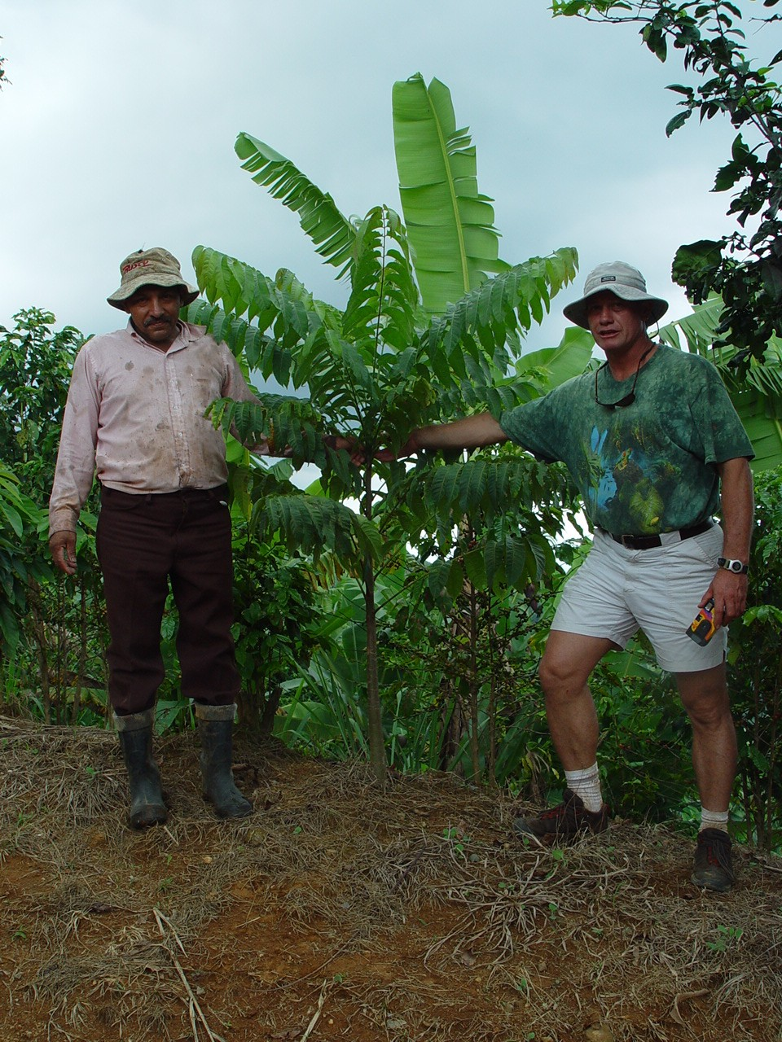
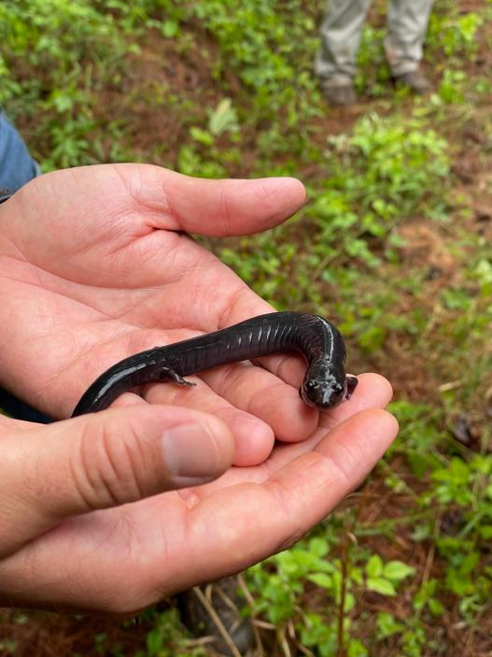
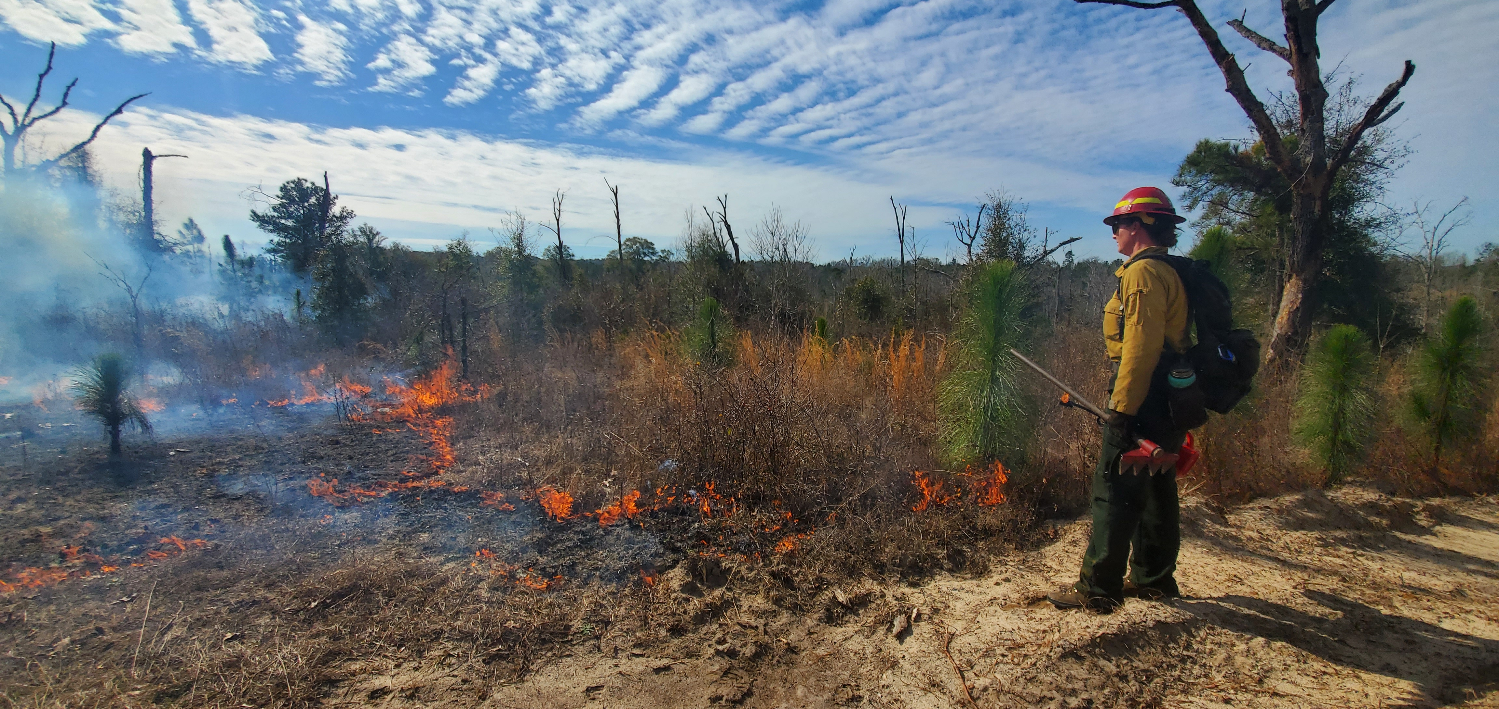
How do we get there?
It’s all about talking less and listening more.
It’s about getting to know each other, as people.
It’s about finding innovation in the Law: “if something isn’t prohibited, it’s allowed”.
We recognize that wildlife can manage itself very well, but managing people is difficult.
We want to develop the new Collaborative Conservation leaders of tomorrow, like you!

Slide 14
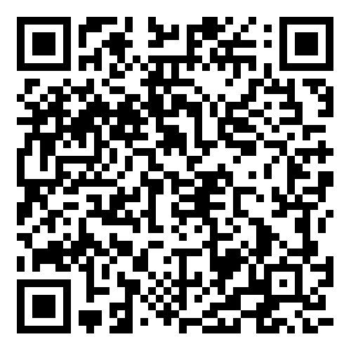
To succeed in conservation, we must shift the paradigm, take risk, and build trust across the board!
“Conservation without Conflict is the future of conservation in America.” – Bullock & Dohner, 2023

