Slide 1
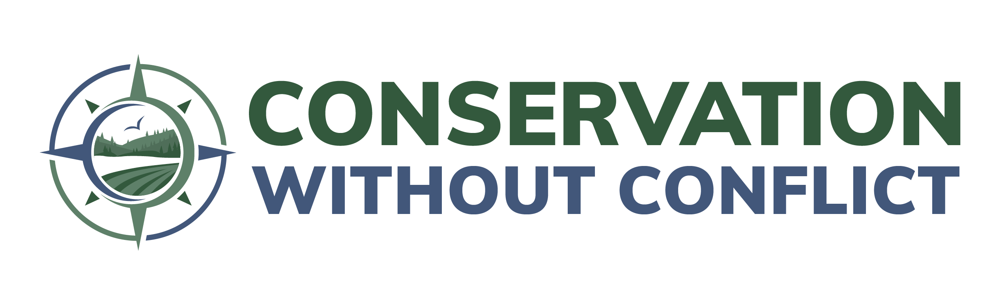

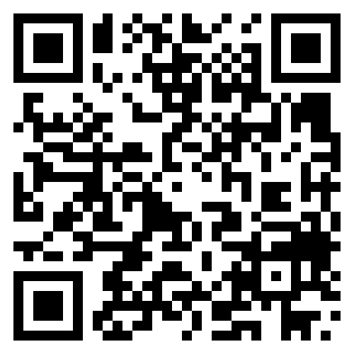
Innovations in Conservation
Reclaiming Collaboration, Trust, and the Ecosystem Mandate
Leo Miranda-Castro
Executive Director
Conservation without Conflict Coalition
Missouri Natural Resources Conference
Osage Beach, MO
February 4, 2026

Slide 2
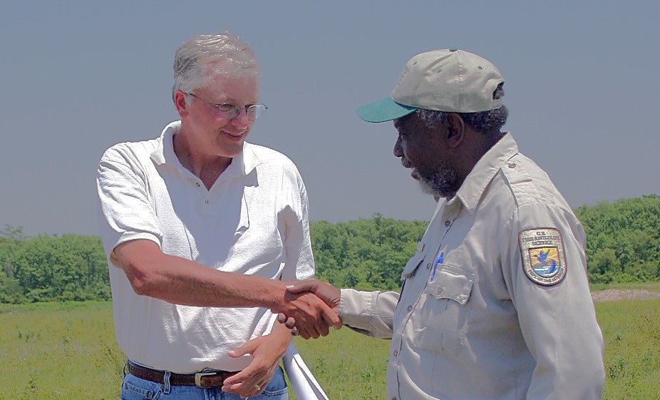
TEXT

Slide 3


The 8 Steps to Achieve Collaborative Conservation
Embrace the local context—listen first.
Empower meaningful engagement of landowners and communities.
Unite around clearly shared goals.
Implement adaptive management—learn as you go.
Foster sustainable livelihoods alongside conservation.
Build capacity for landowners and local partners.
Establish simple, inclusive collaborative governance.
Cultivate continuous communication and shared learning.
Scan for more details

Slide 4
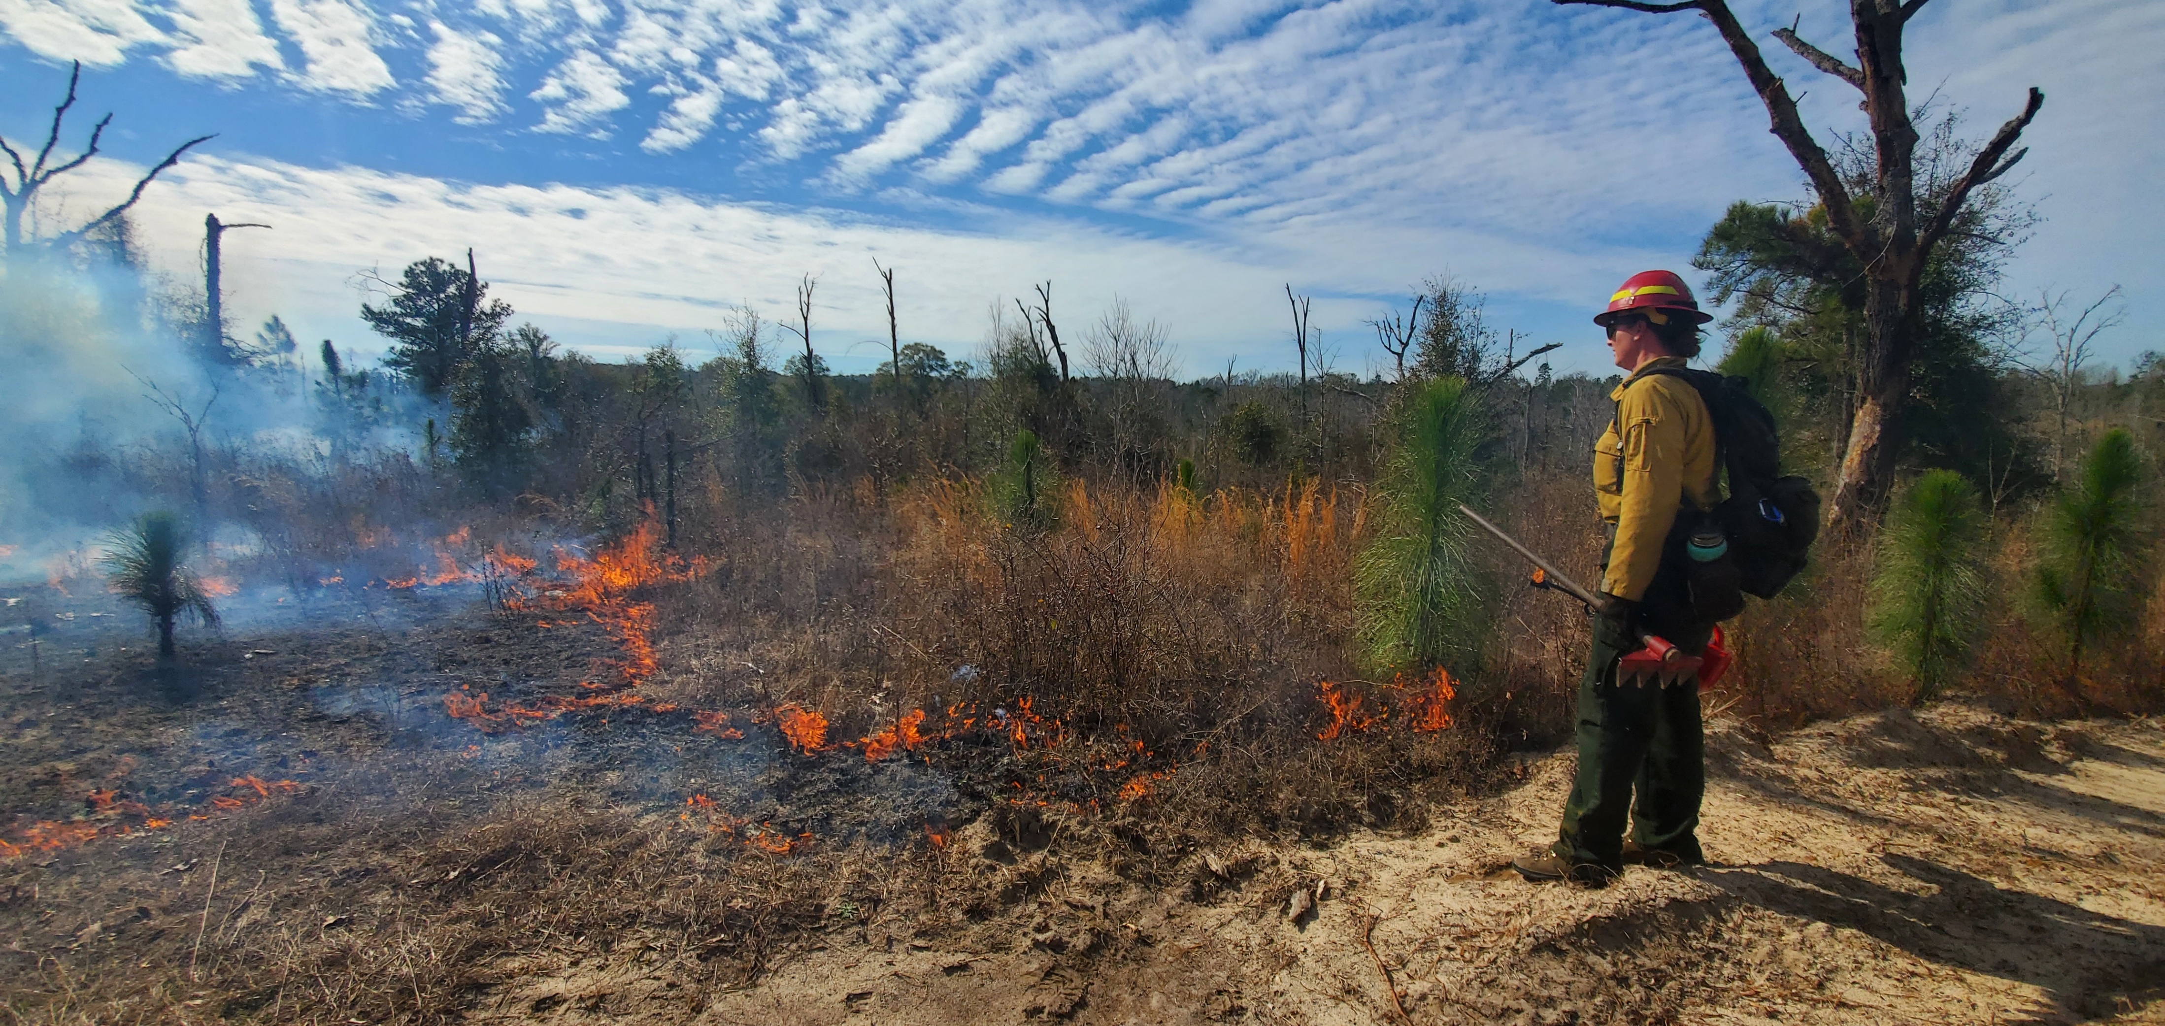

Slide 5



Slide 6
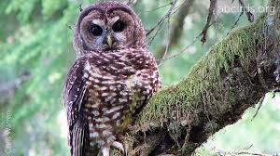
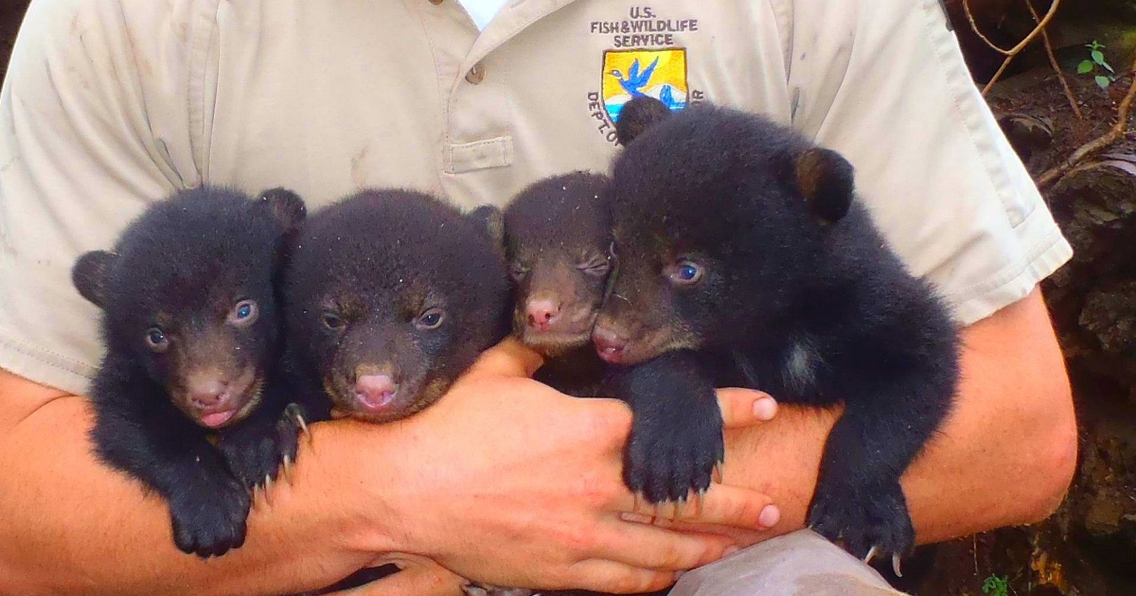
Same Summer, Different Stories
June 23, 1990
Northern spotted owl
listed as threatened
June 21, 1990
Louisiana black bear threatened listing proposed

Slide 7
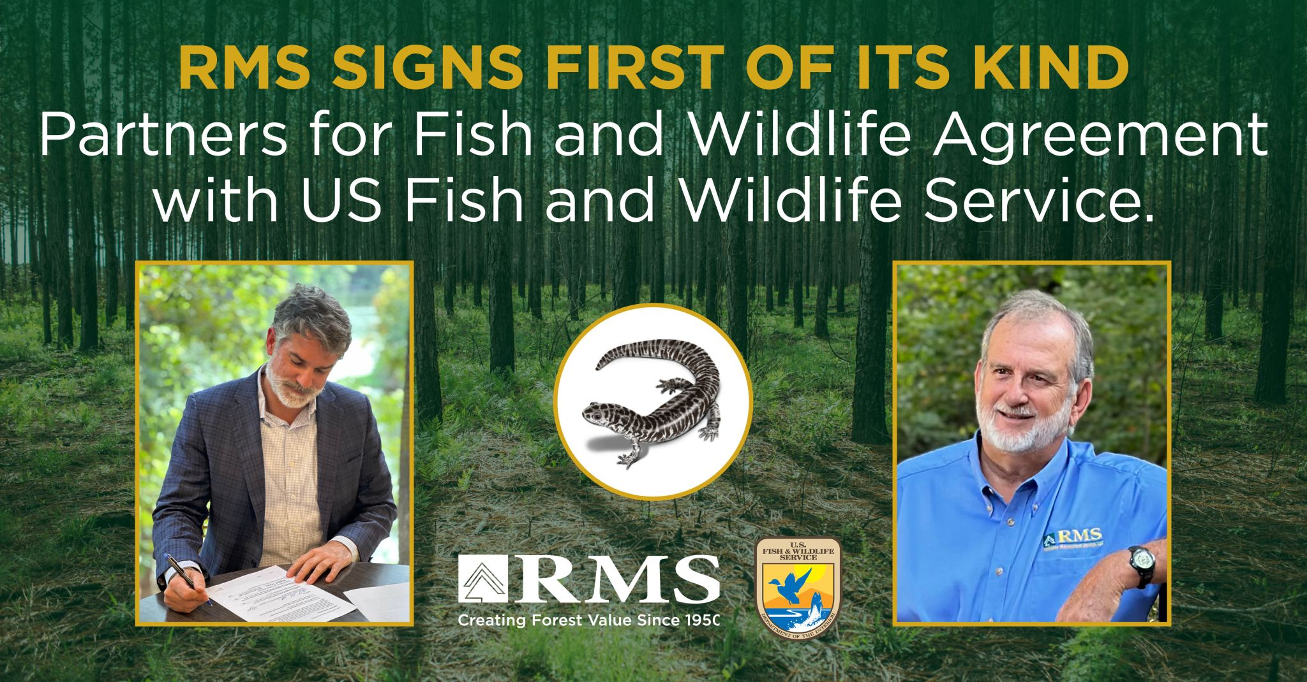


Slide 8
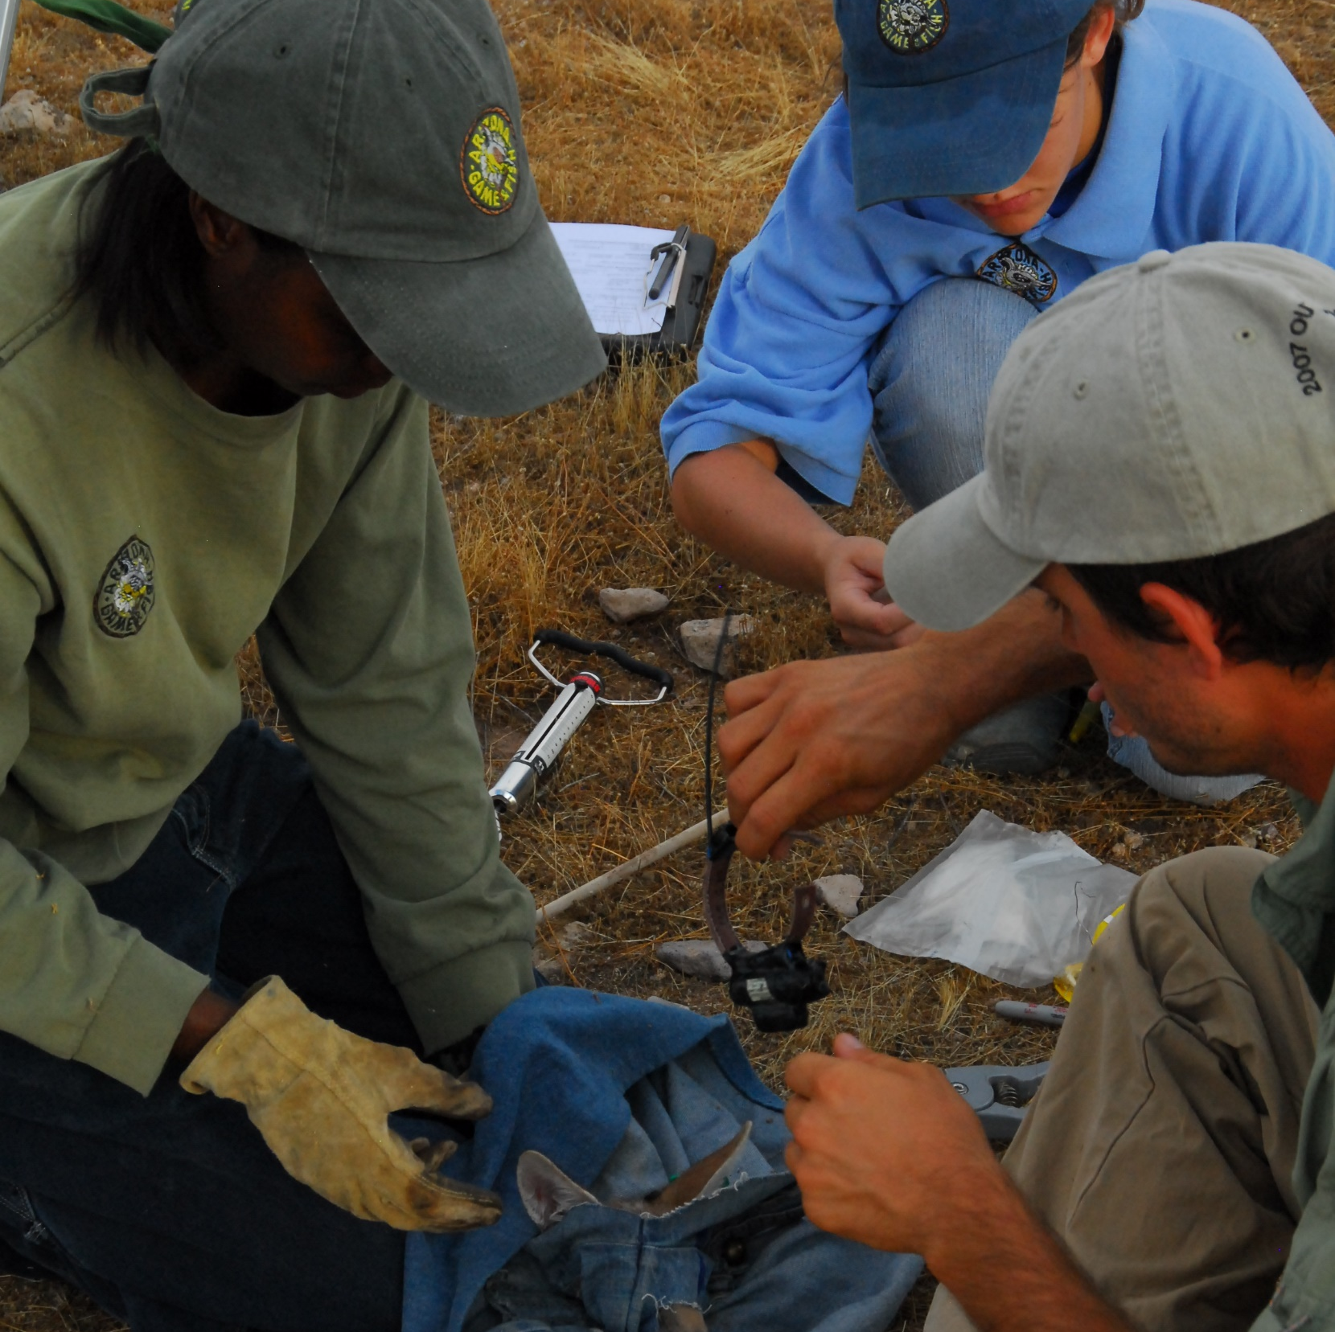
The Future of Conservation Is in Your Hands
I am confident you will shape it with wisdom, courage, and unrelenting creativity.
Be innovative and bold
Build trust through collaboration
Reclaim the ecosystem vision
Partner with private landowners
Gracias!

